Slide 1
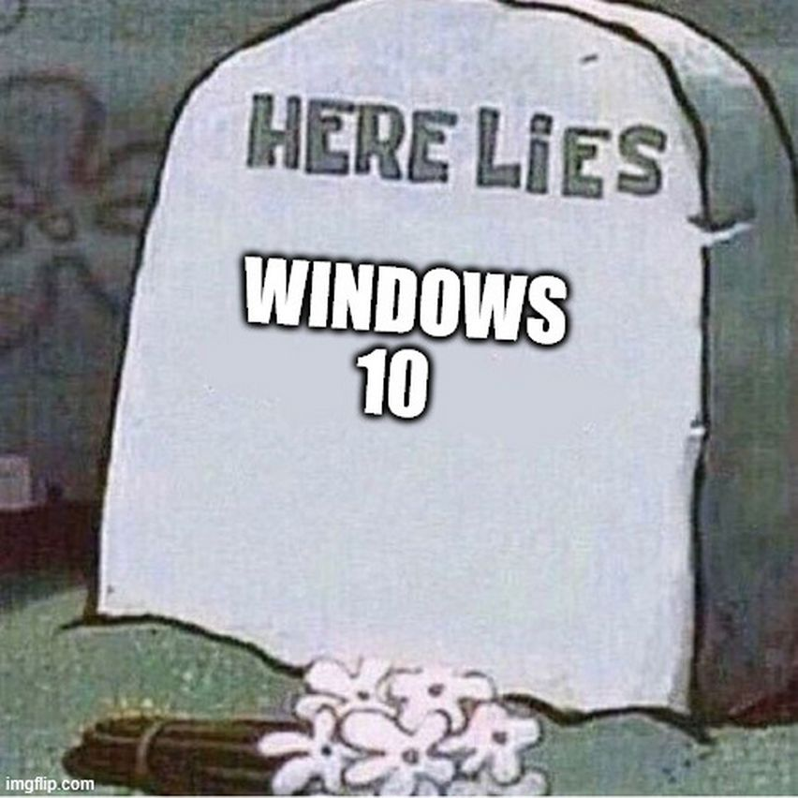
Linux and The End of Windows 10

Slide 2
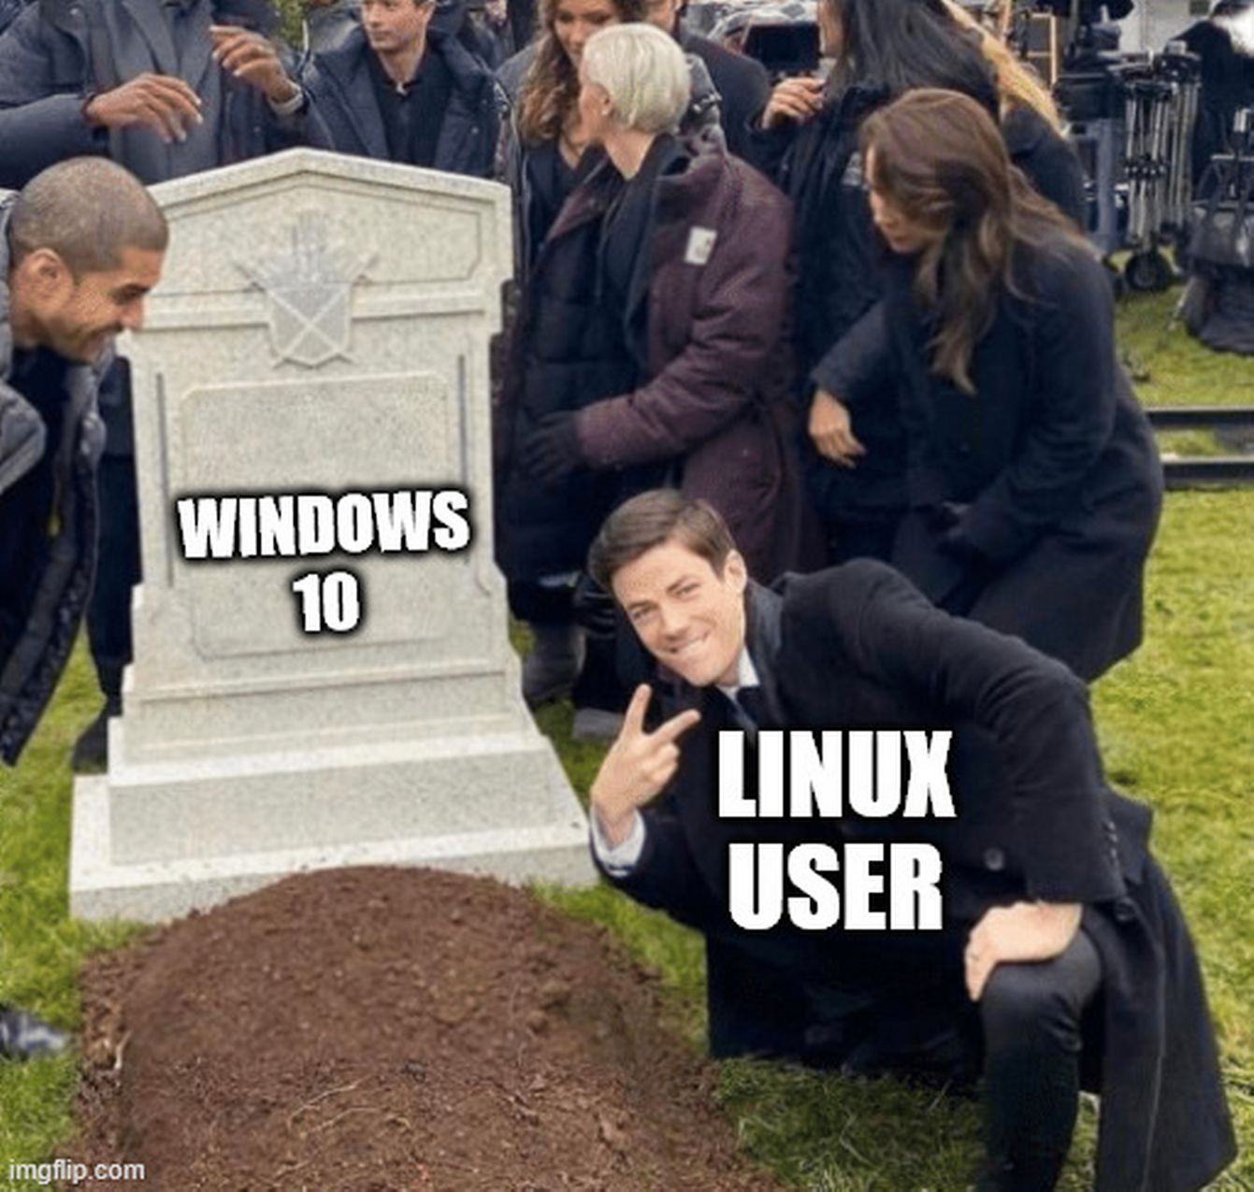
Topics 🕵🏽
Windows and hardware 🪟
Check hardware ⚙️
Linux and FOSS 🐧
Hands-on trying Linux and installing FOSS & Linux 🖖🏾

Slide 3

Let’s introduce! 🫱🏽‍🫲🏿
Name
Pronouns
Favorite app/software
(No browser)
Experience with Computer/Windows/ macOS/Linux
Expectations
Superpower

Slide 4
What will happen on October 15?
Anniversary of death of Thomas Sankara ✊🏿
End of Windows 10 support
China launches first manned space mission 🚀

Slide 5
What will happen on October 15?
Anniversary of death of Thomas Sankara ✊🏿 (1987)
End of Windows 10 support (2025)
China launches first manned space mission 🚀 (2003)

Slide 6
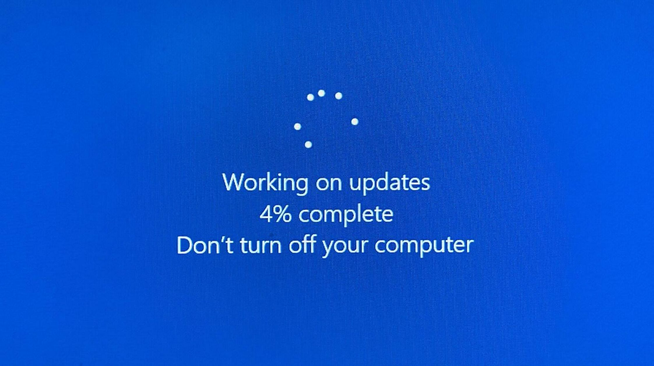

What does “End of Windows 10” mean? 💁🏽‍♀️

Slide 7
What options do we have? 🎟️
Upgrade to windows 11 (hardware support?)
Pay for extended support of windows 10 (30$ or data)
Use win10 unsupported (security?)
Switch to Linux and enjoy freedom!

Slide 8

What even is a computer? 🔬
Software:
User Software (e.g. Firefox, Signal, VLC, LibreOffice, Obsidan, …)
Operating System (e.g. Linux, Windows, macOS)
Hardware:
CPU 🧮
RAM (memory) 📄
Storage 📚

Slide 9
Let’s check our hardware!
Windows10:
Settings
About
Linux :
$ lscpu
$ lsmem
macOS/iOS:
System Settings
General
About
Android:
Settings
About Phone
Detailed Info

Slide 10

The End of Windows 10: Good News or Bad News

Slide 11
The End of Windows 10: Bad News
Security Updates end
Vulnerable to hacking
Windows 11 only supports hardware > 2015
Windows 11 is spyware
Even more ads in start menu
Copilot+ Recall

Slide 12
The End of Windows 10: Good News
You can in theory still run Windows 10
No more disrupting updates
Prices for old hardware drops
Linux runs smoothly on this hardware

Slide 13

My Path from Windows to Linux
Windows 95
Windows XP
Windows 7
Windows 8
Dual Boot: Mint
Full Linux

Slide 14

What I hate about Windows
Microsoft account
Ads in Windows
Telemetry
Edge and Bing
User interface
The command line
Proprietary code

Slide 15


Slide 16
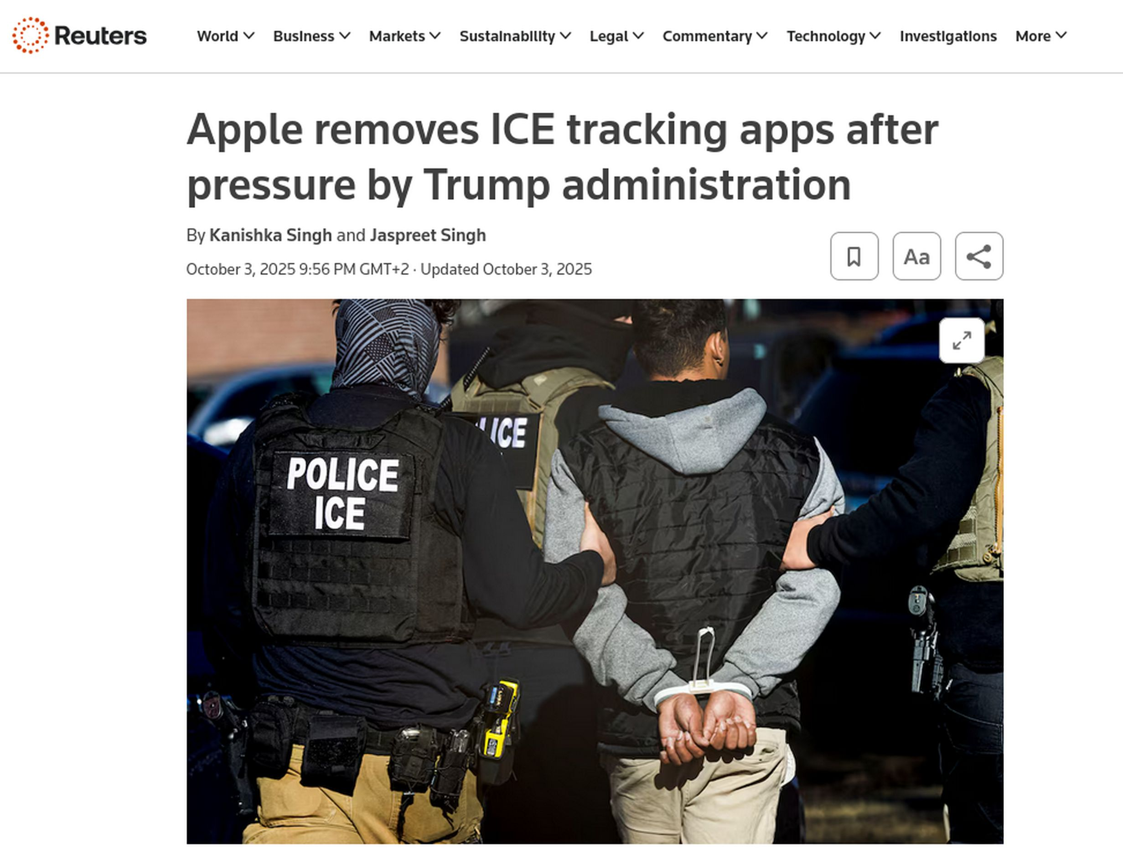

… meanwhile Apple

Slide 17
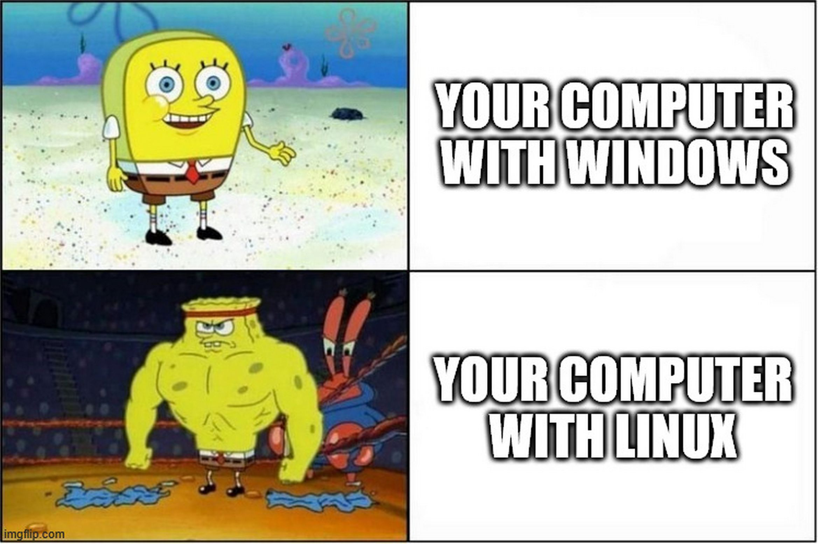

Slide 18
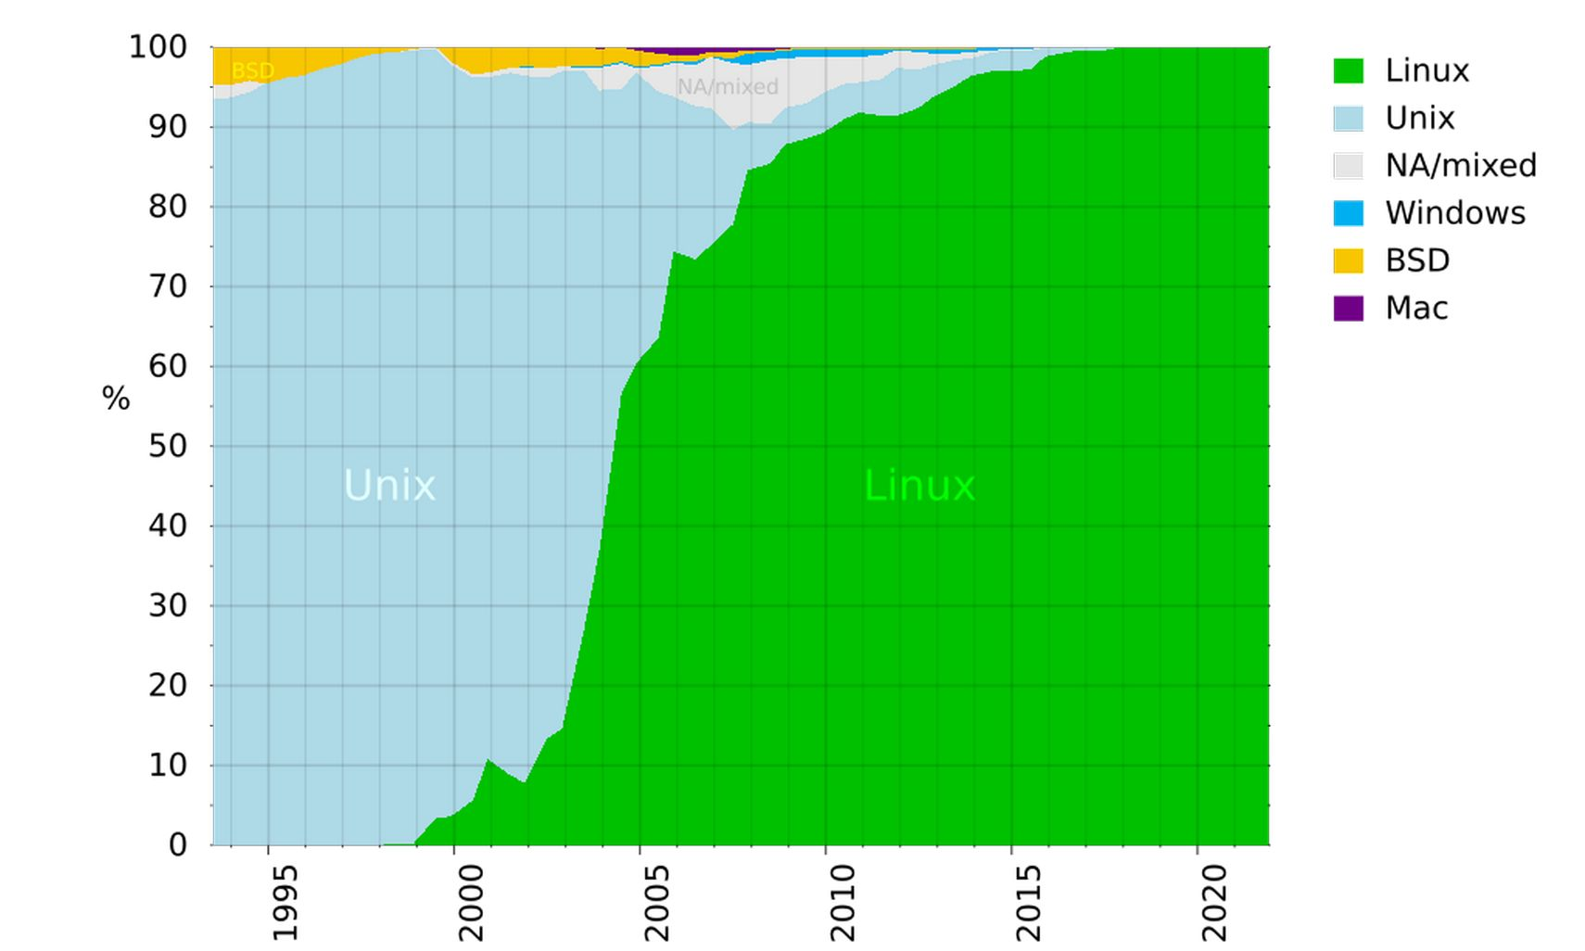
What is Linux?
Operating System
Like Windows, macOS, Android, iOS, …
Basis for
Android
Chromebooks
Amazon Fire TV Stick
Run by:
Danish government
Schleswig Holstein government
Top 500 super computers
PewDiePie

Slide 19

What is Linux?

Slide 20

What is Linux?
Advantages:
Light weight
Customizable (diverse)
Free (FOSS)
No Ads
Privacy respecting
Package management (“App Stores”)
Control (over Updates)

Slide 21
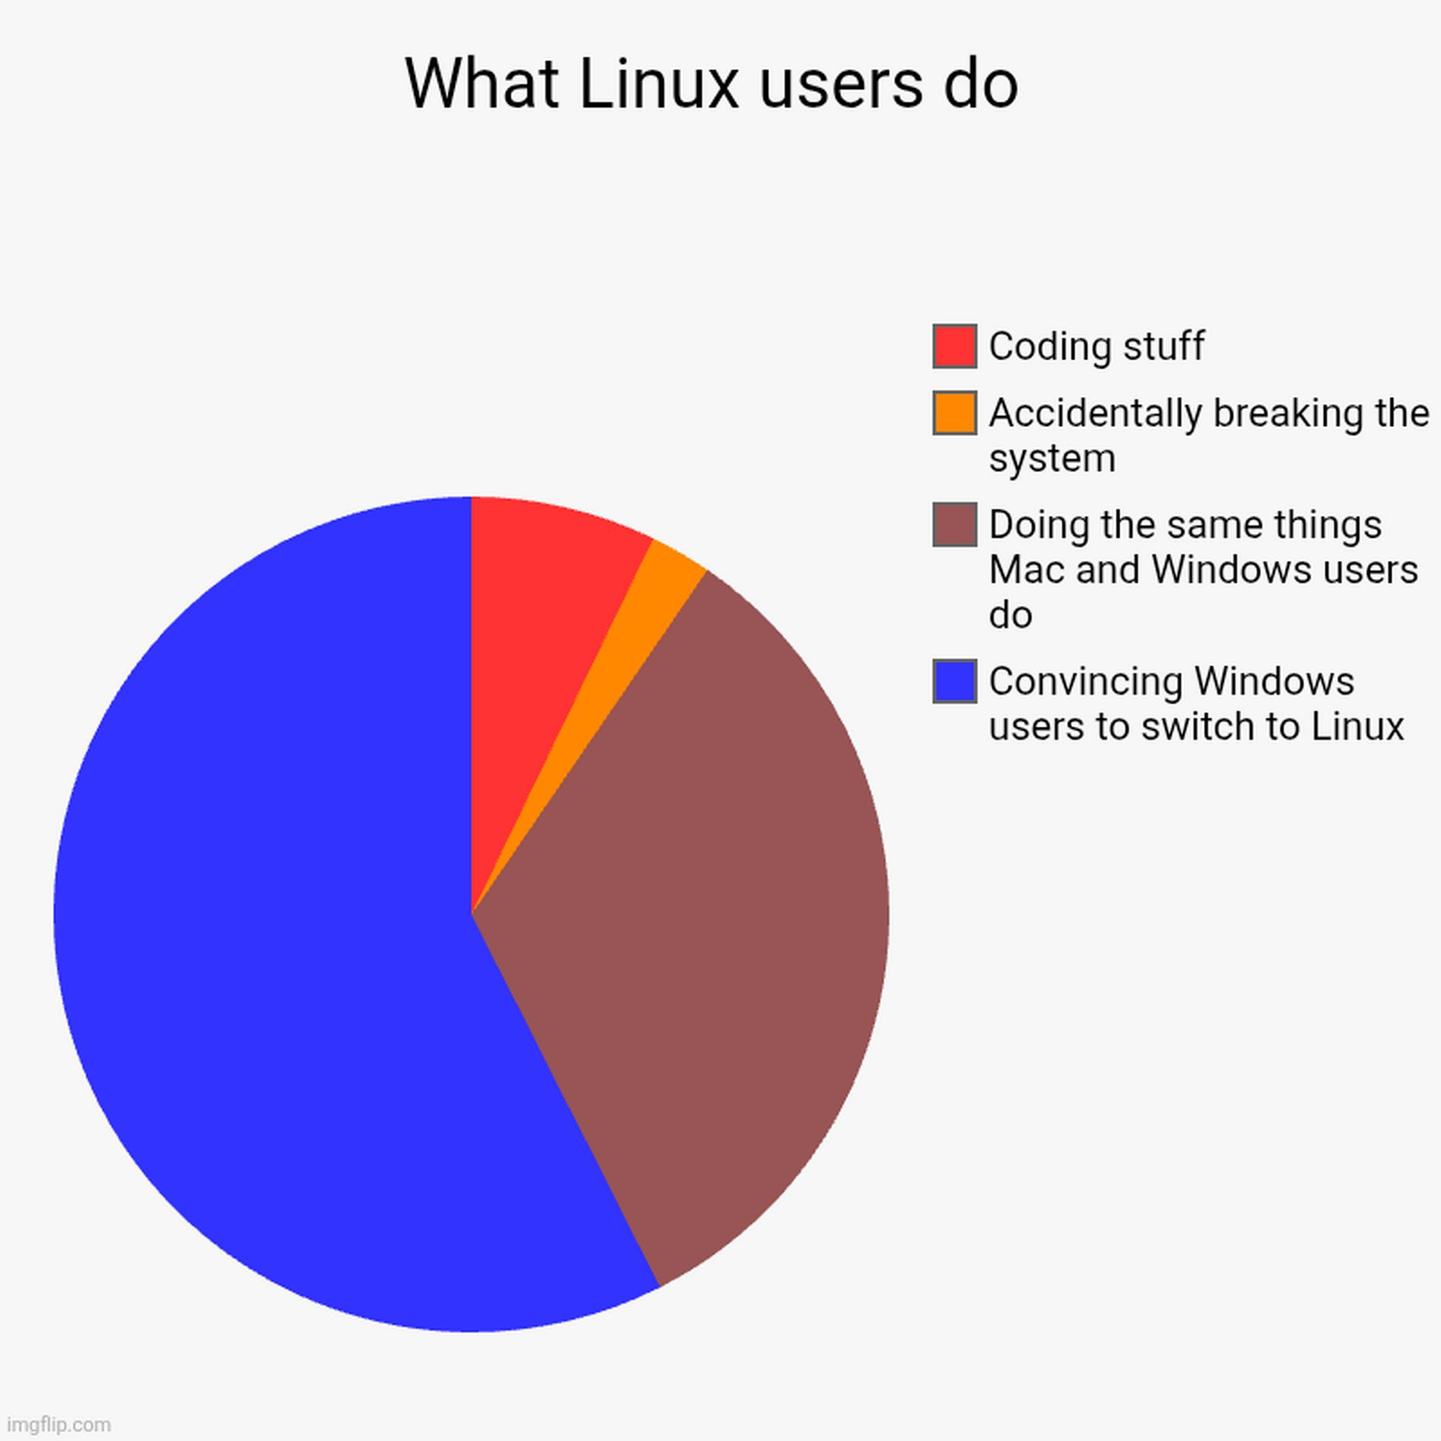

Slide 22



What is Linux?
Disadvantages:
New System (learning curve)
Some apps aren’t supported (e.g. microsoft, adobe, CAD)
Hardware support
Too many choices

Slide 23
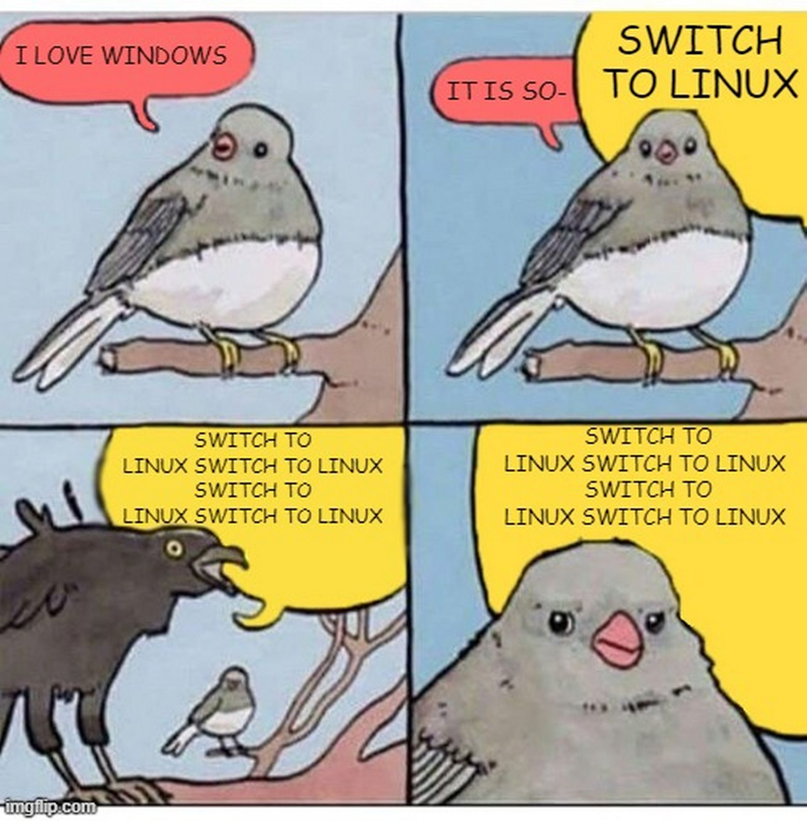

Slide 24
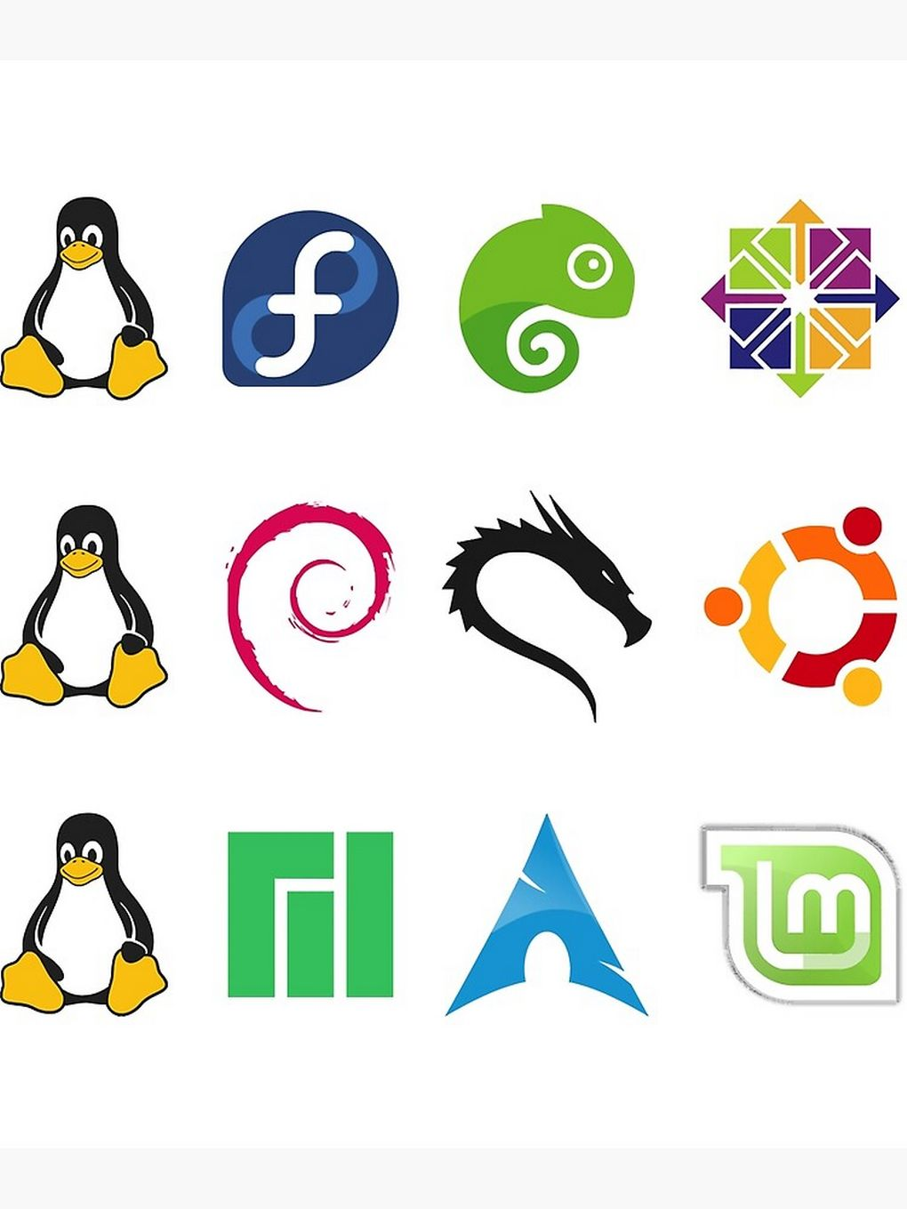

What is Linux?
Desktop Environment (DE) + package manager = Linux Distros
Ubuntu
Mint
Debian
Fedora
Arch

Slide 25
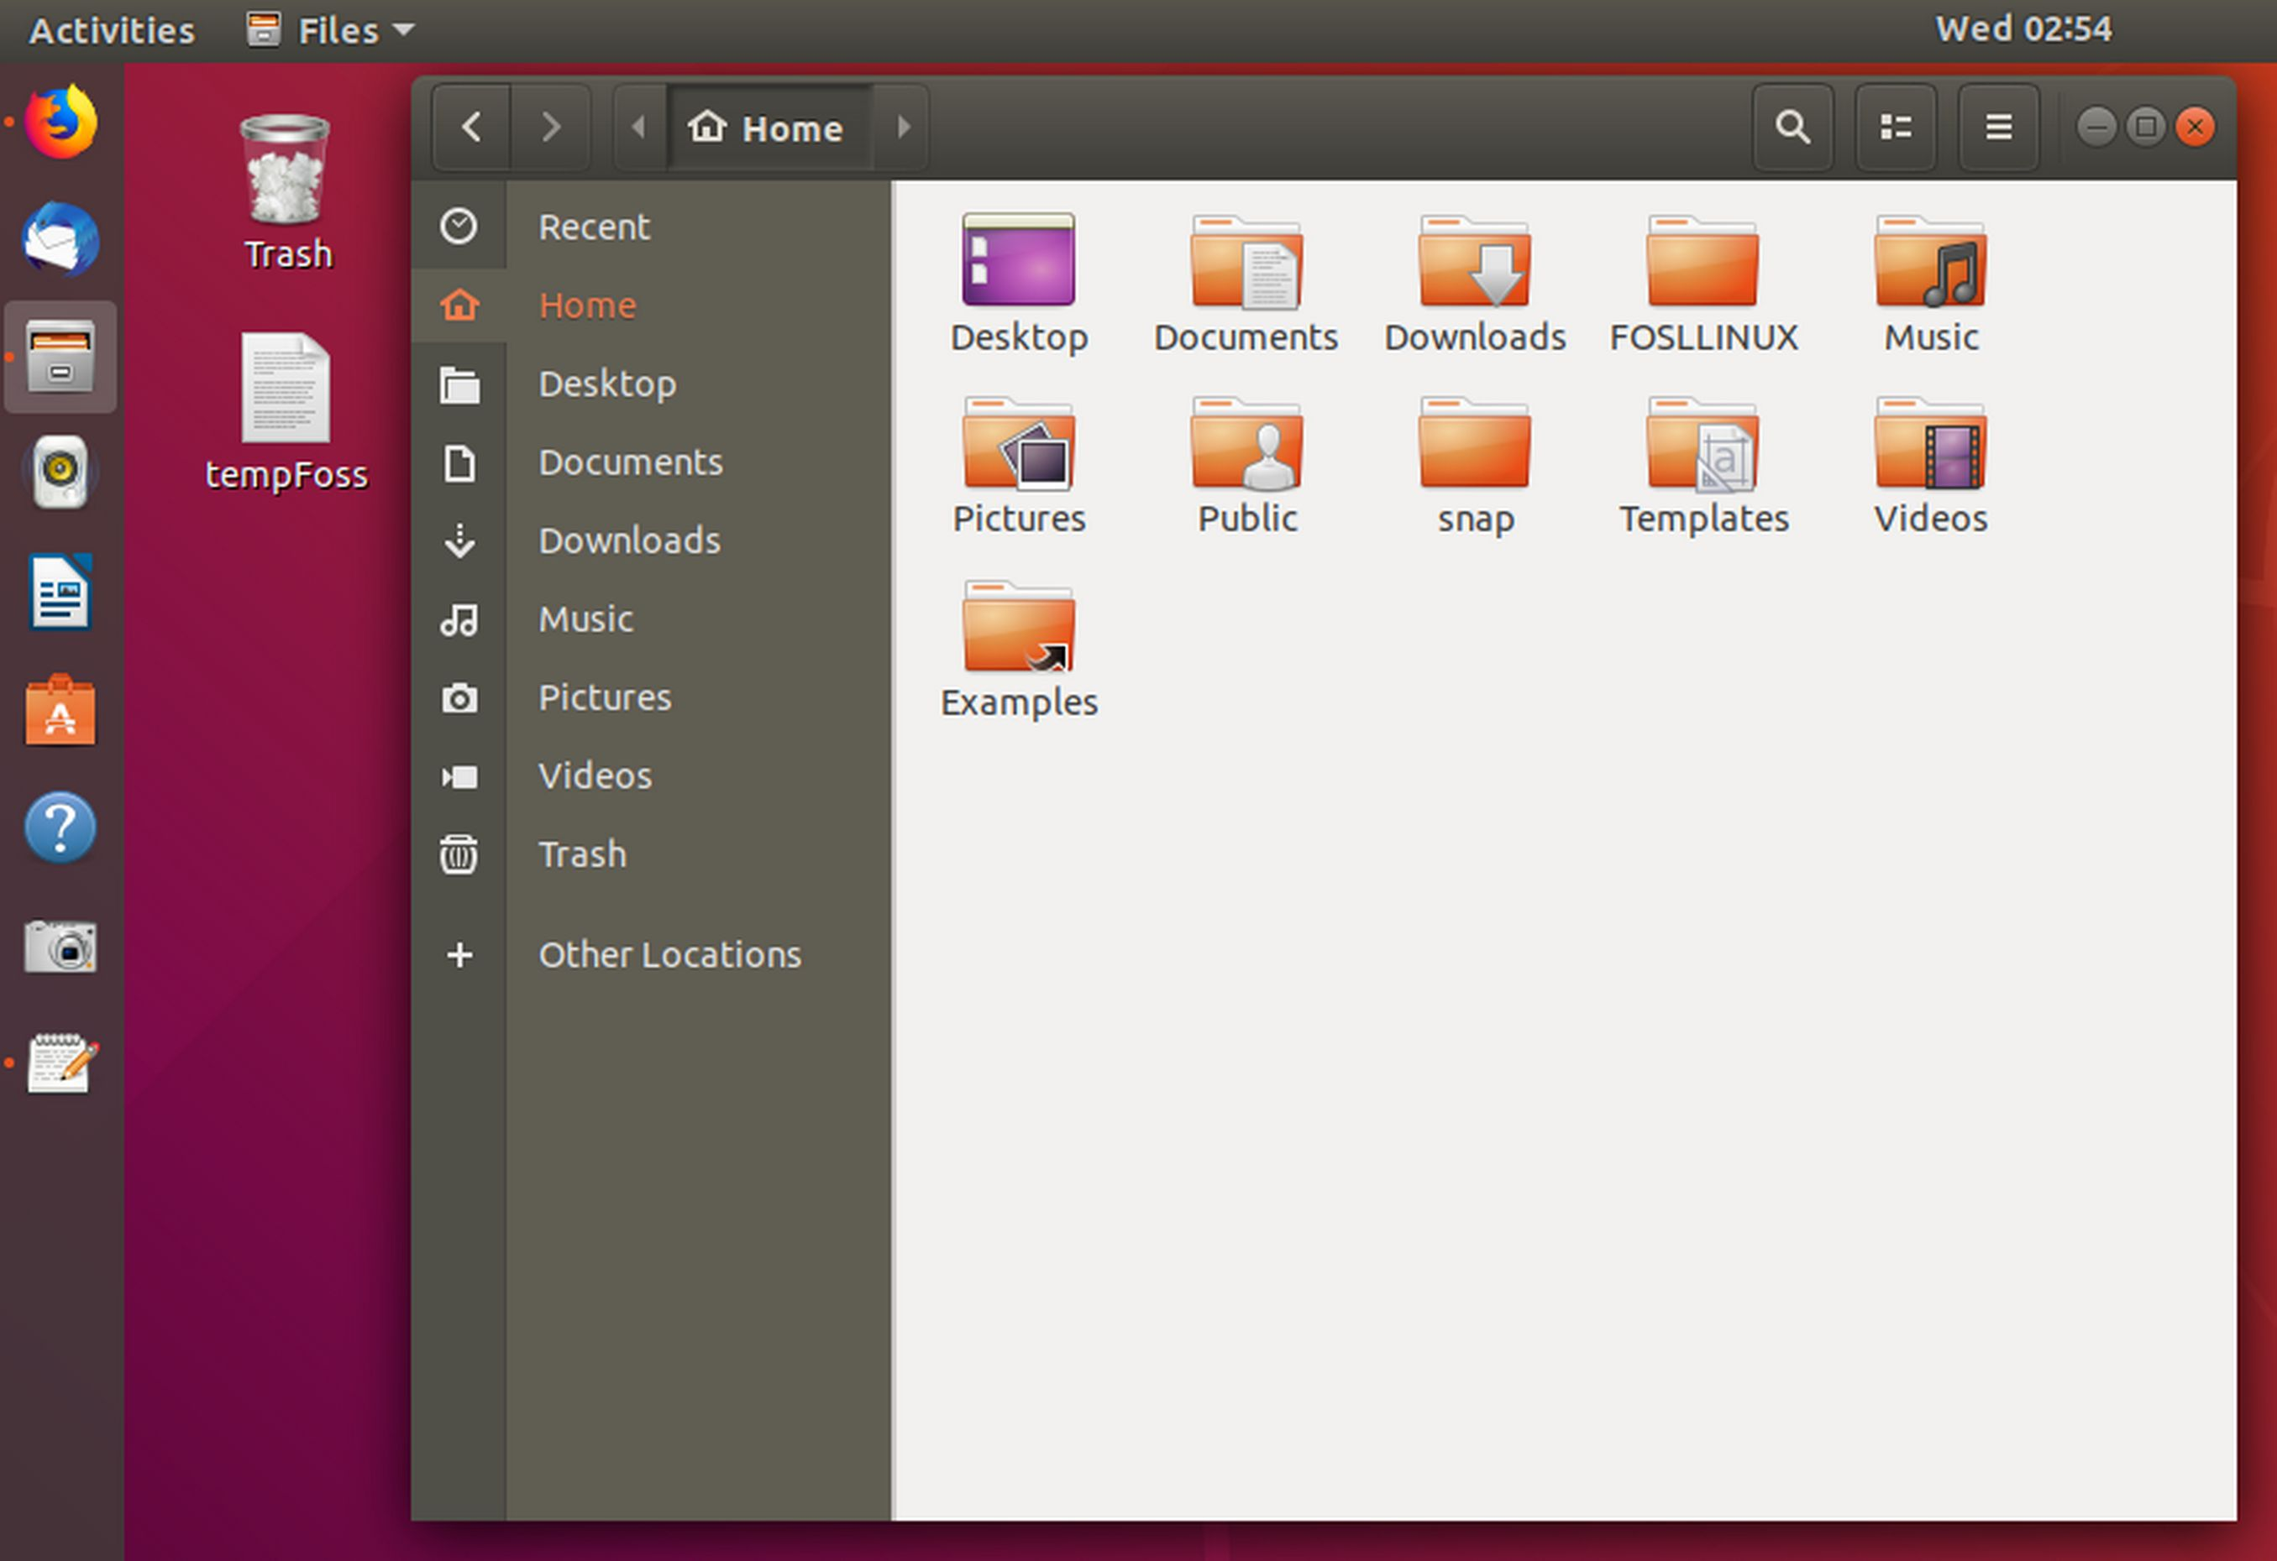
Ubuntu

Slide 26
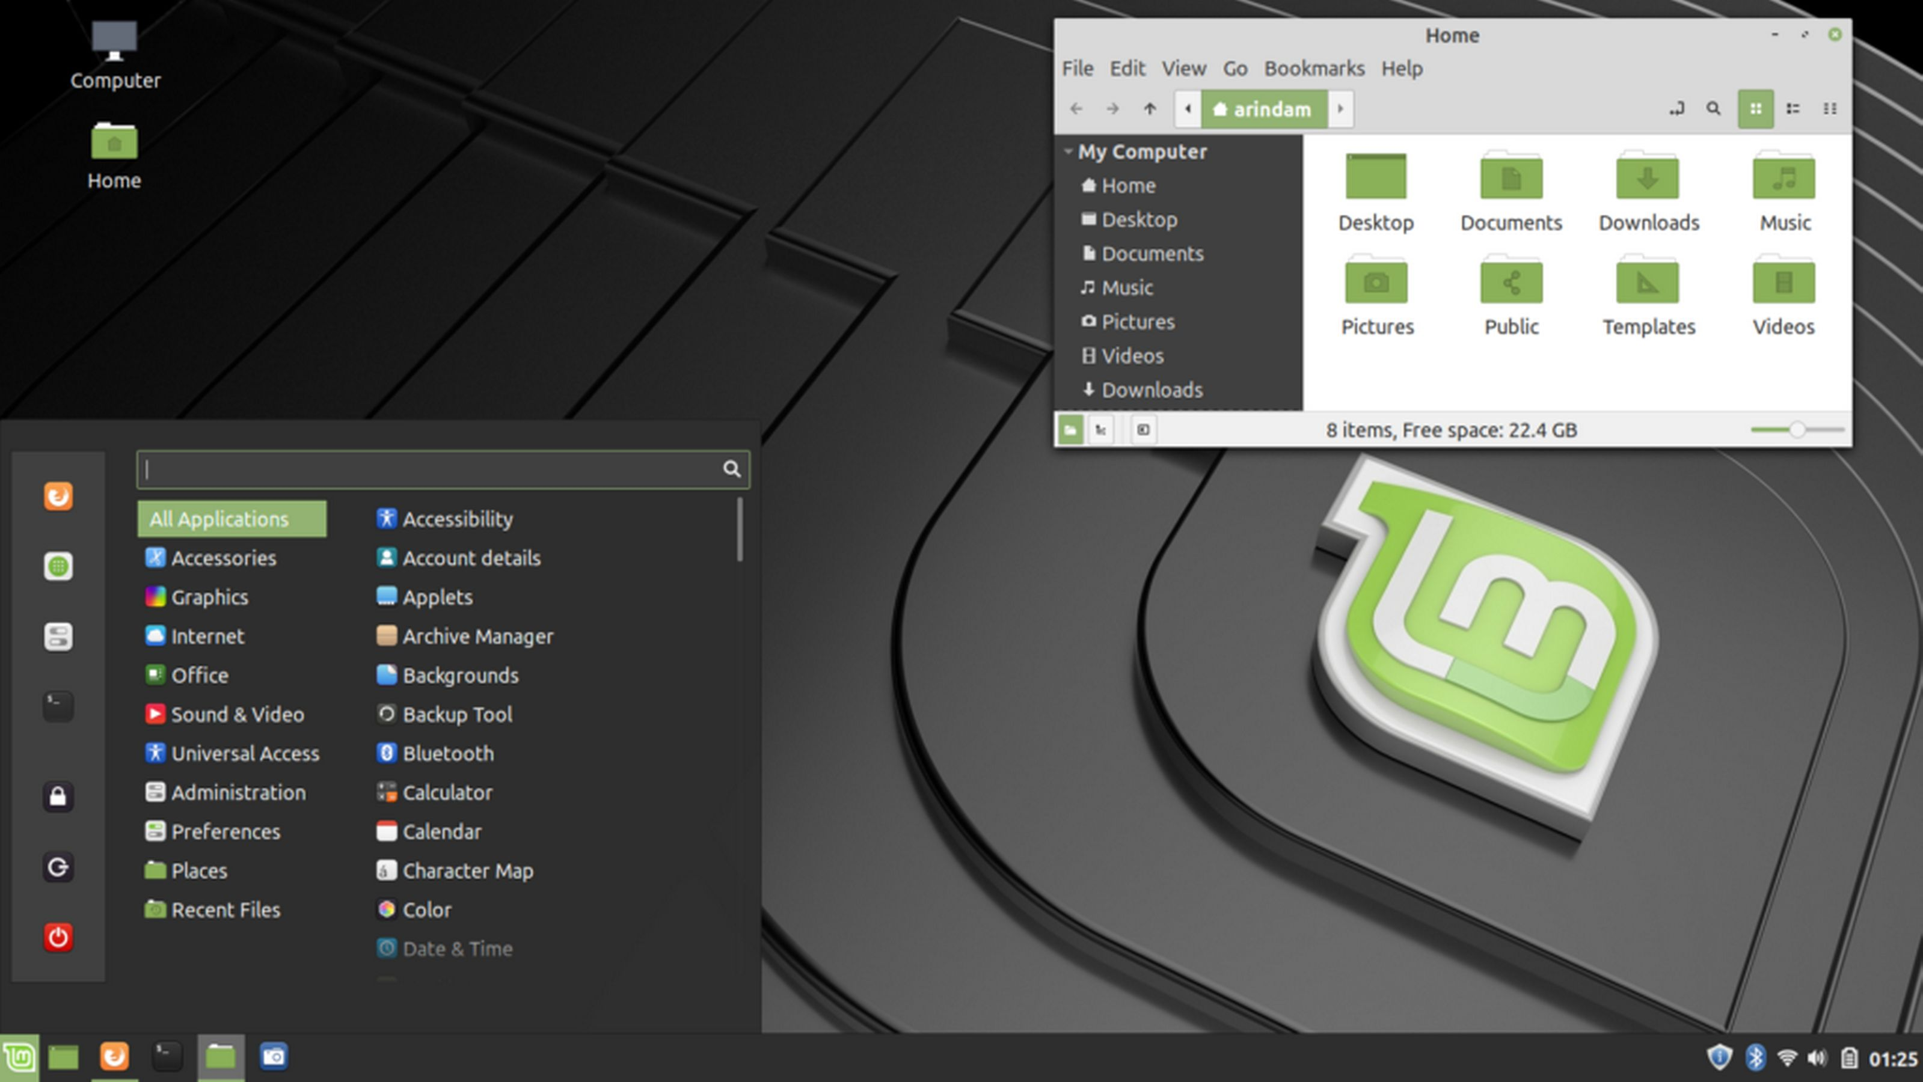


Slide 27
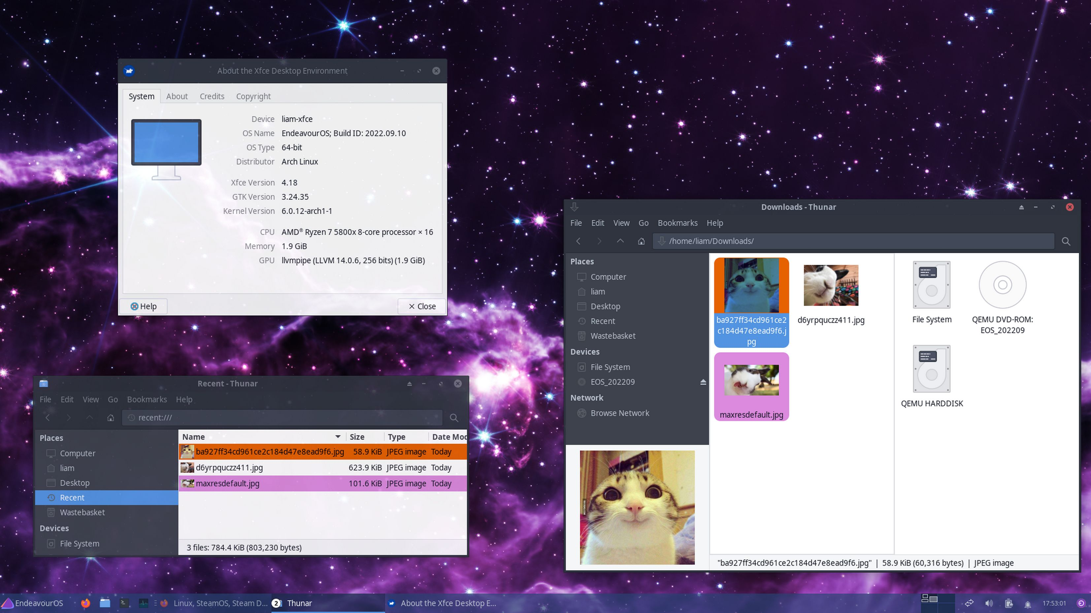

Slide 28
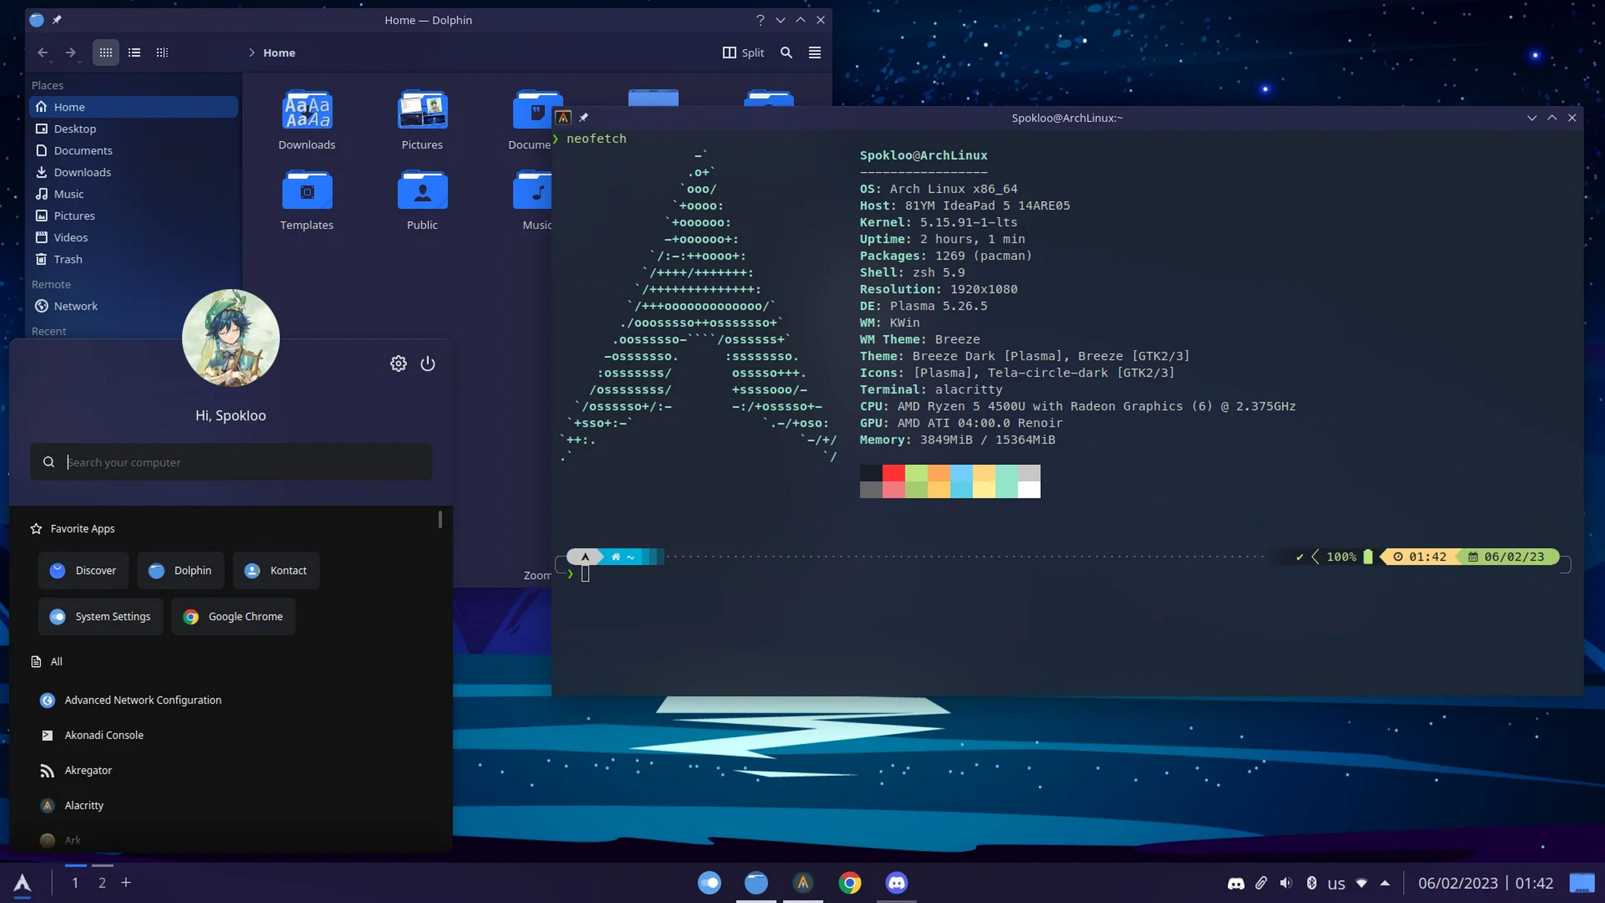

Slide 29
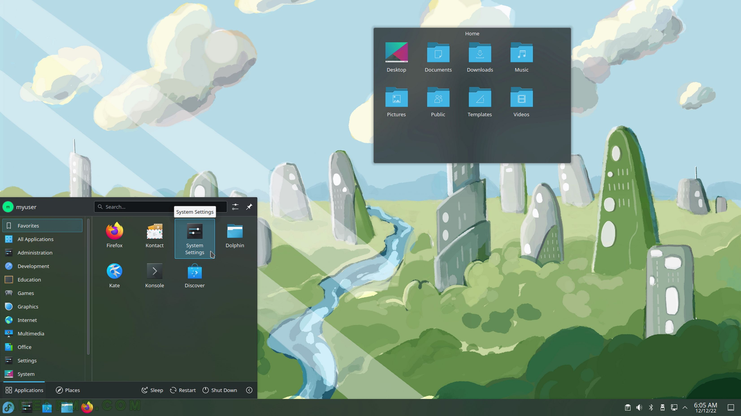

Slide 30
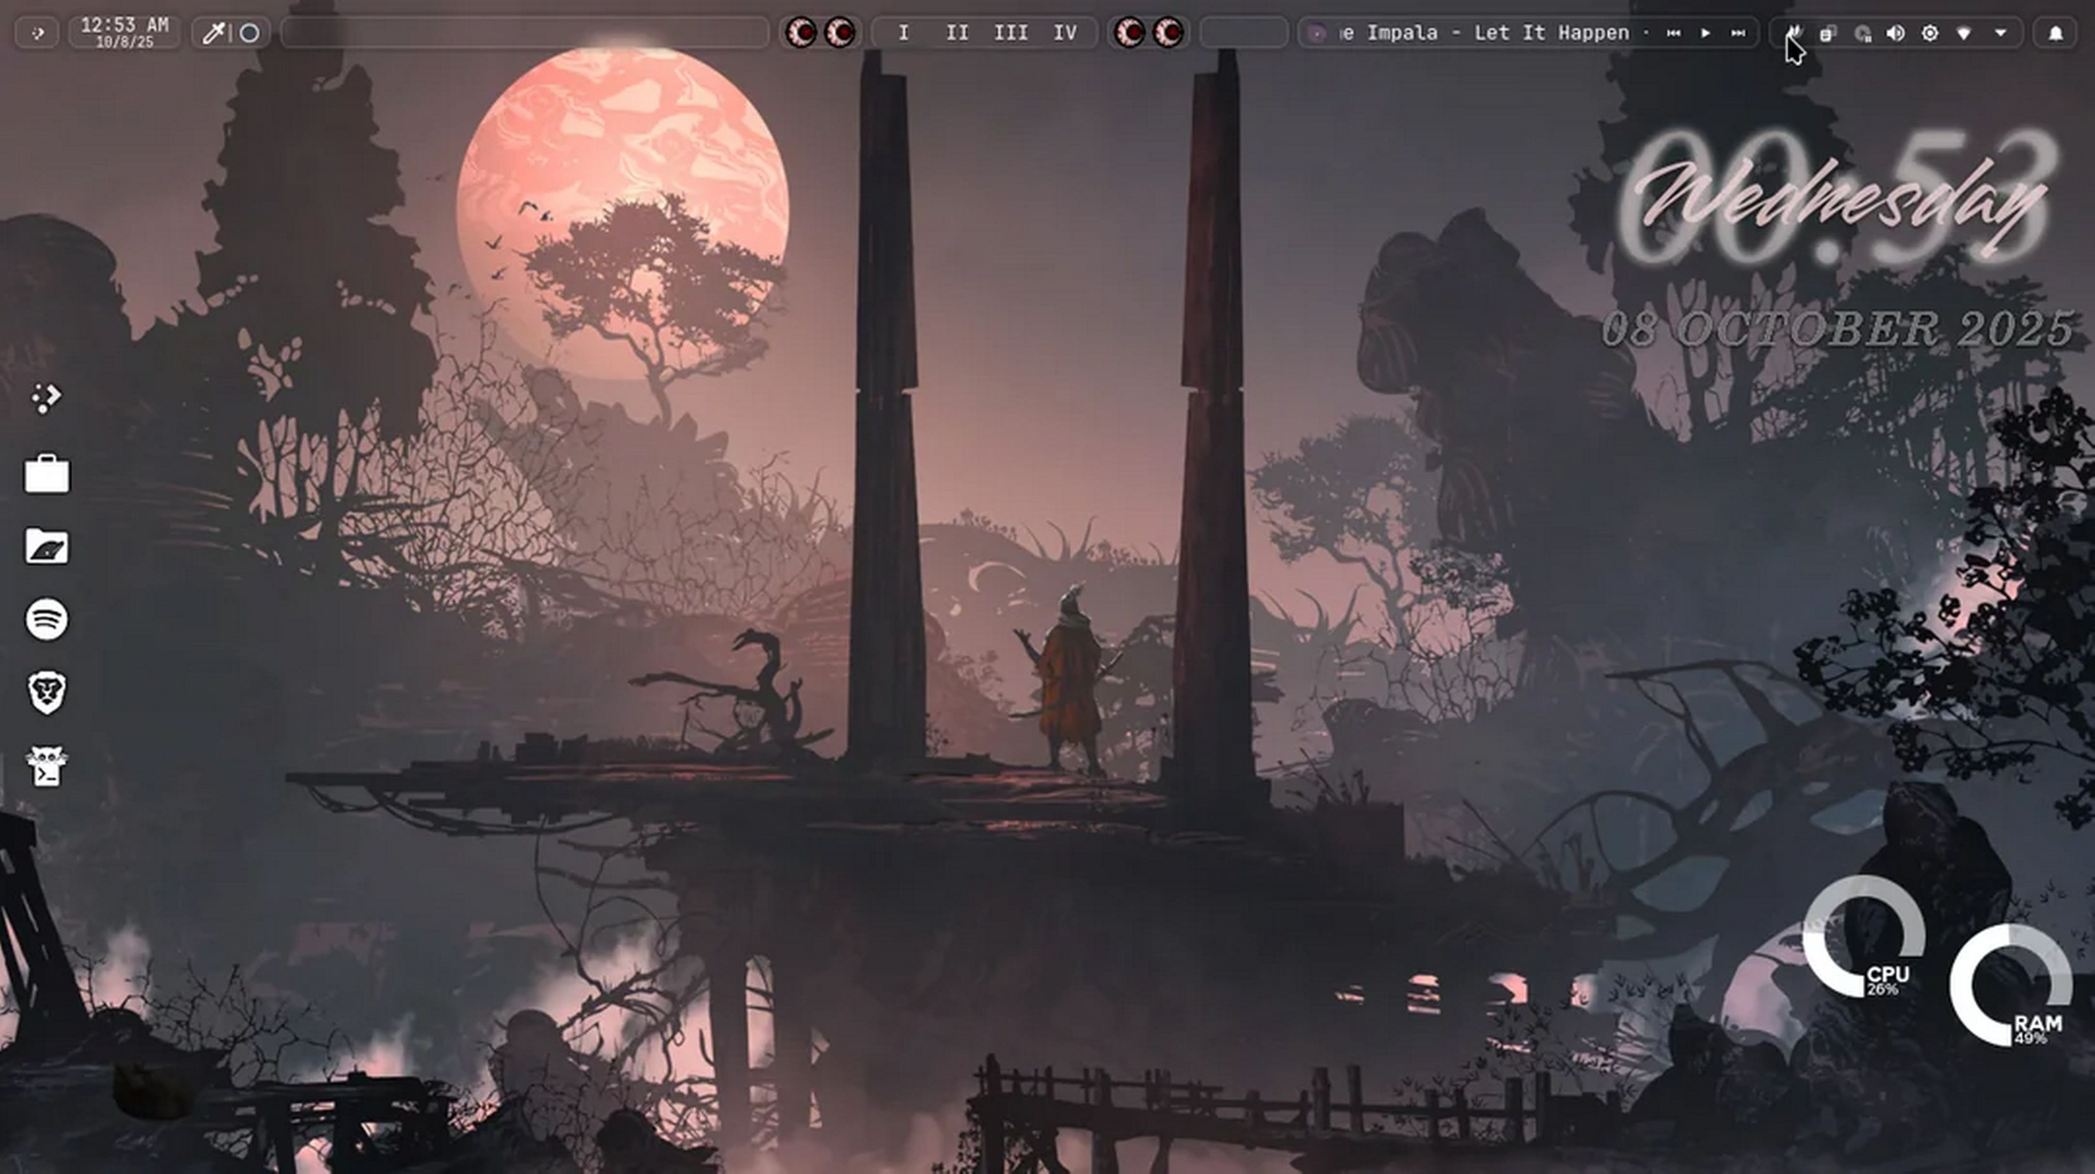

Slide 31
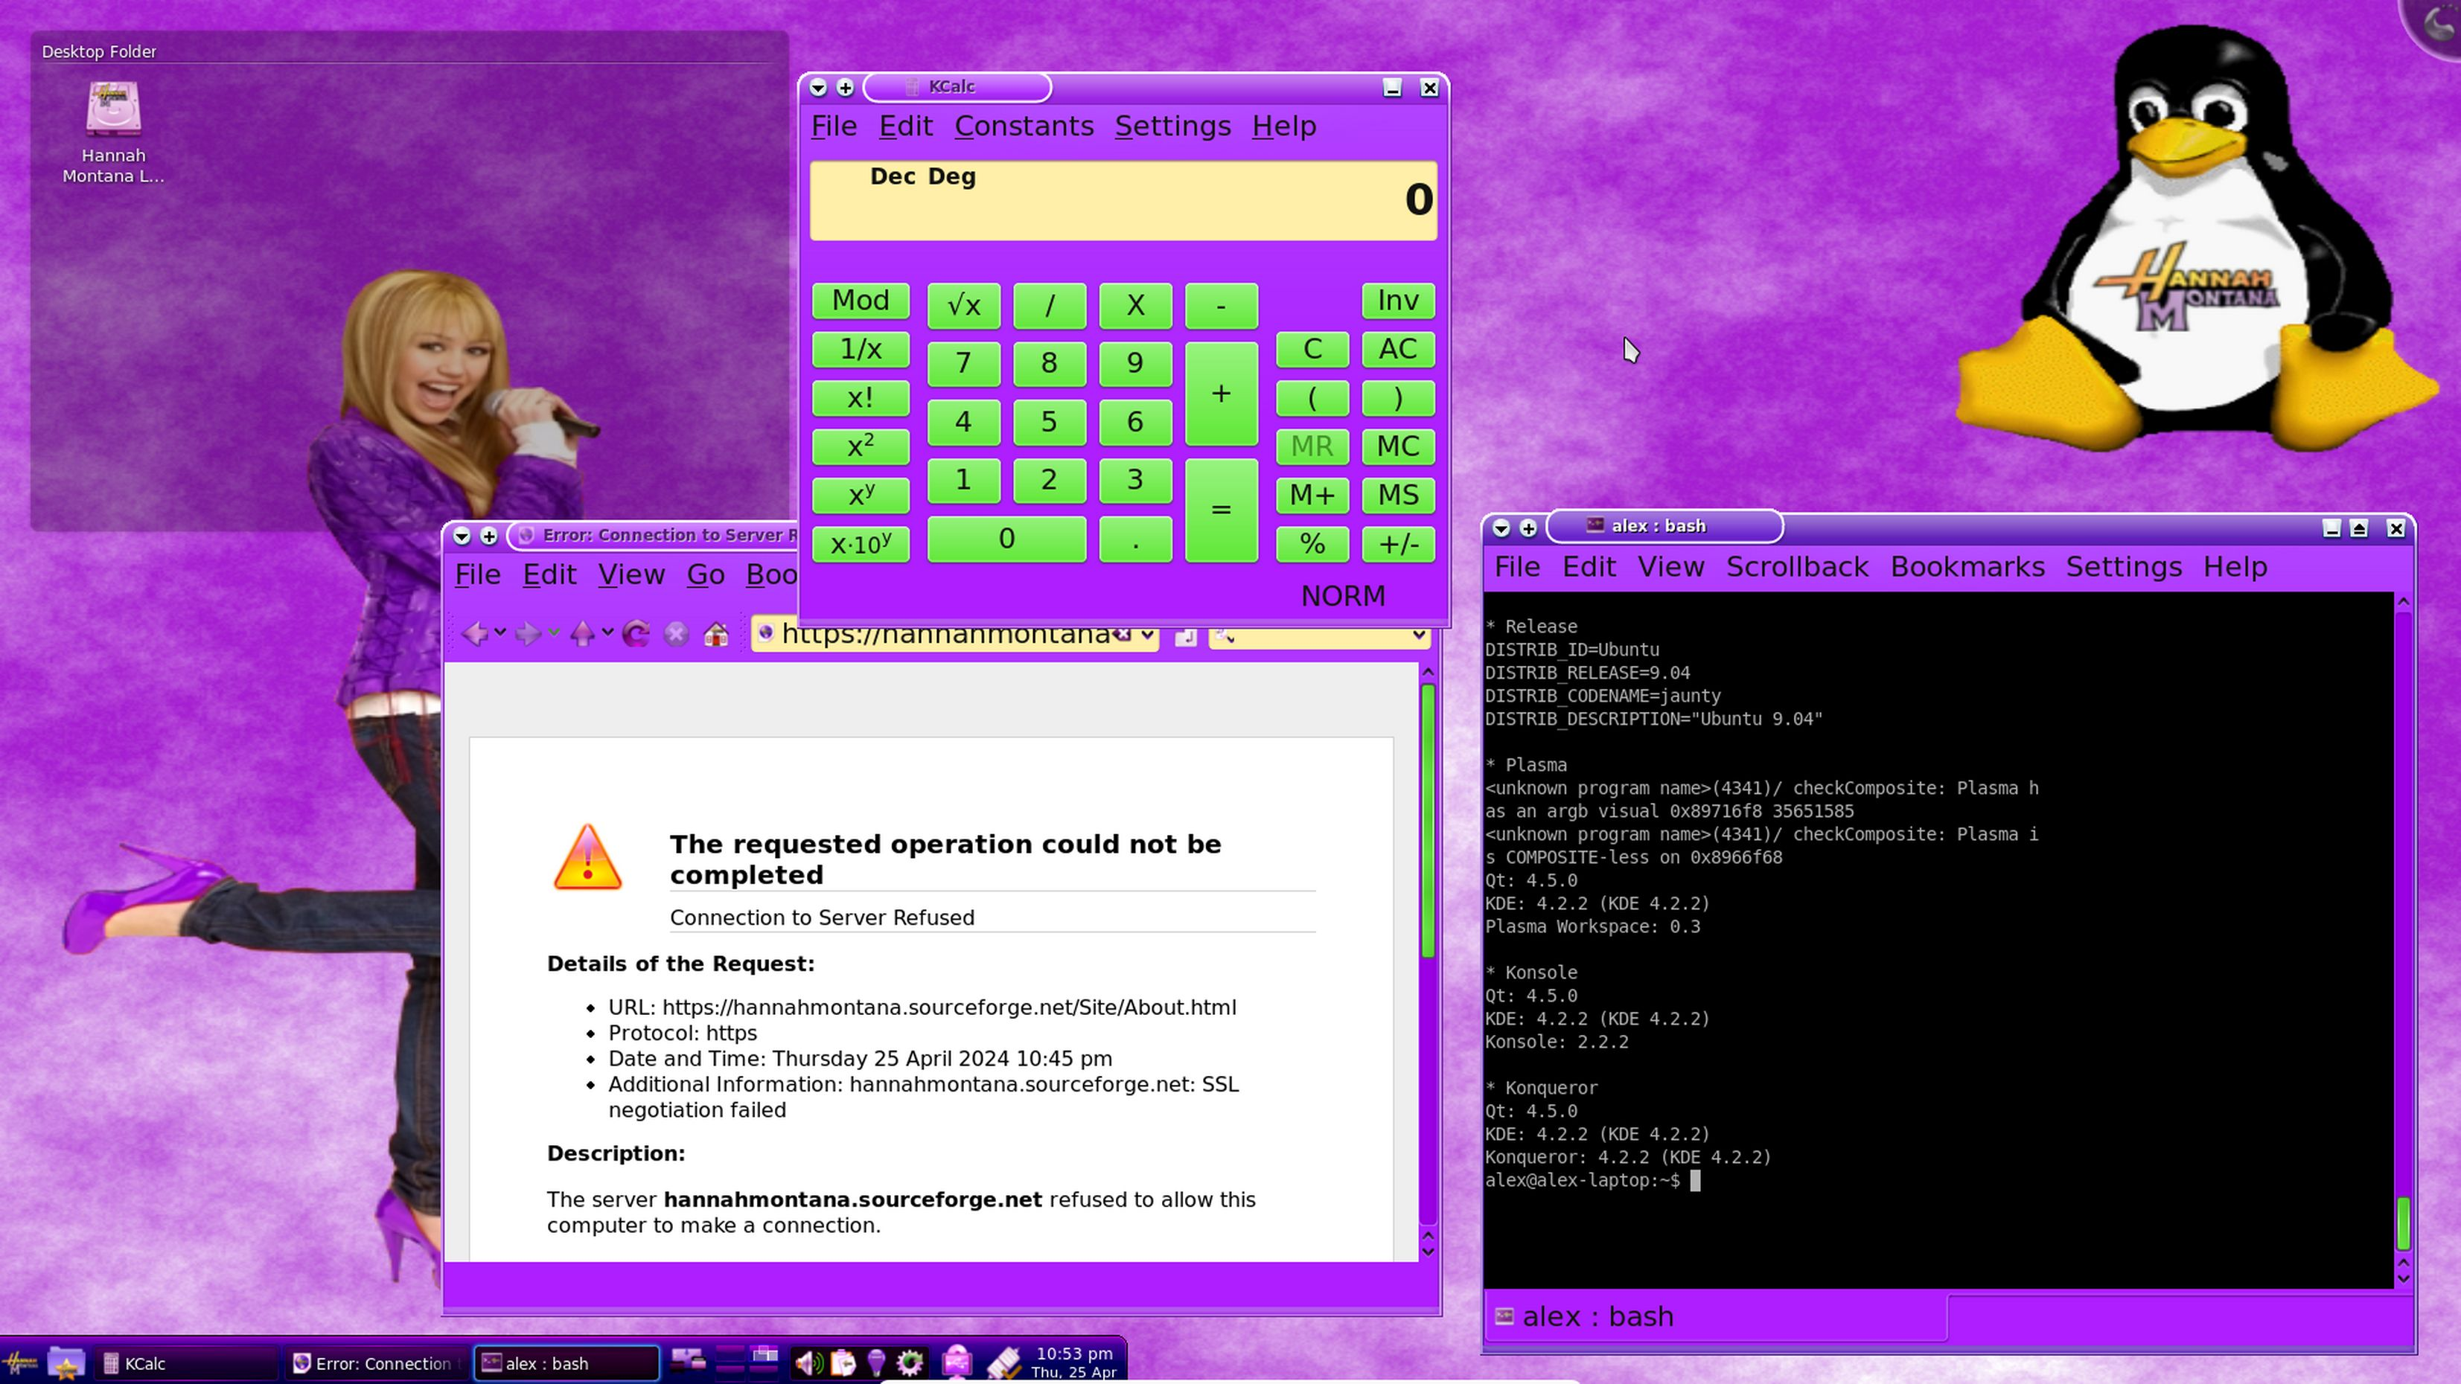

Slide 32
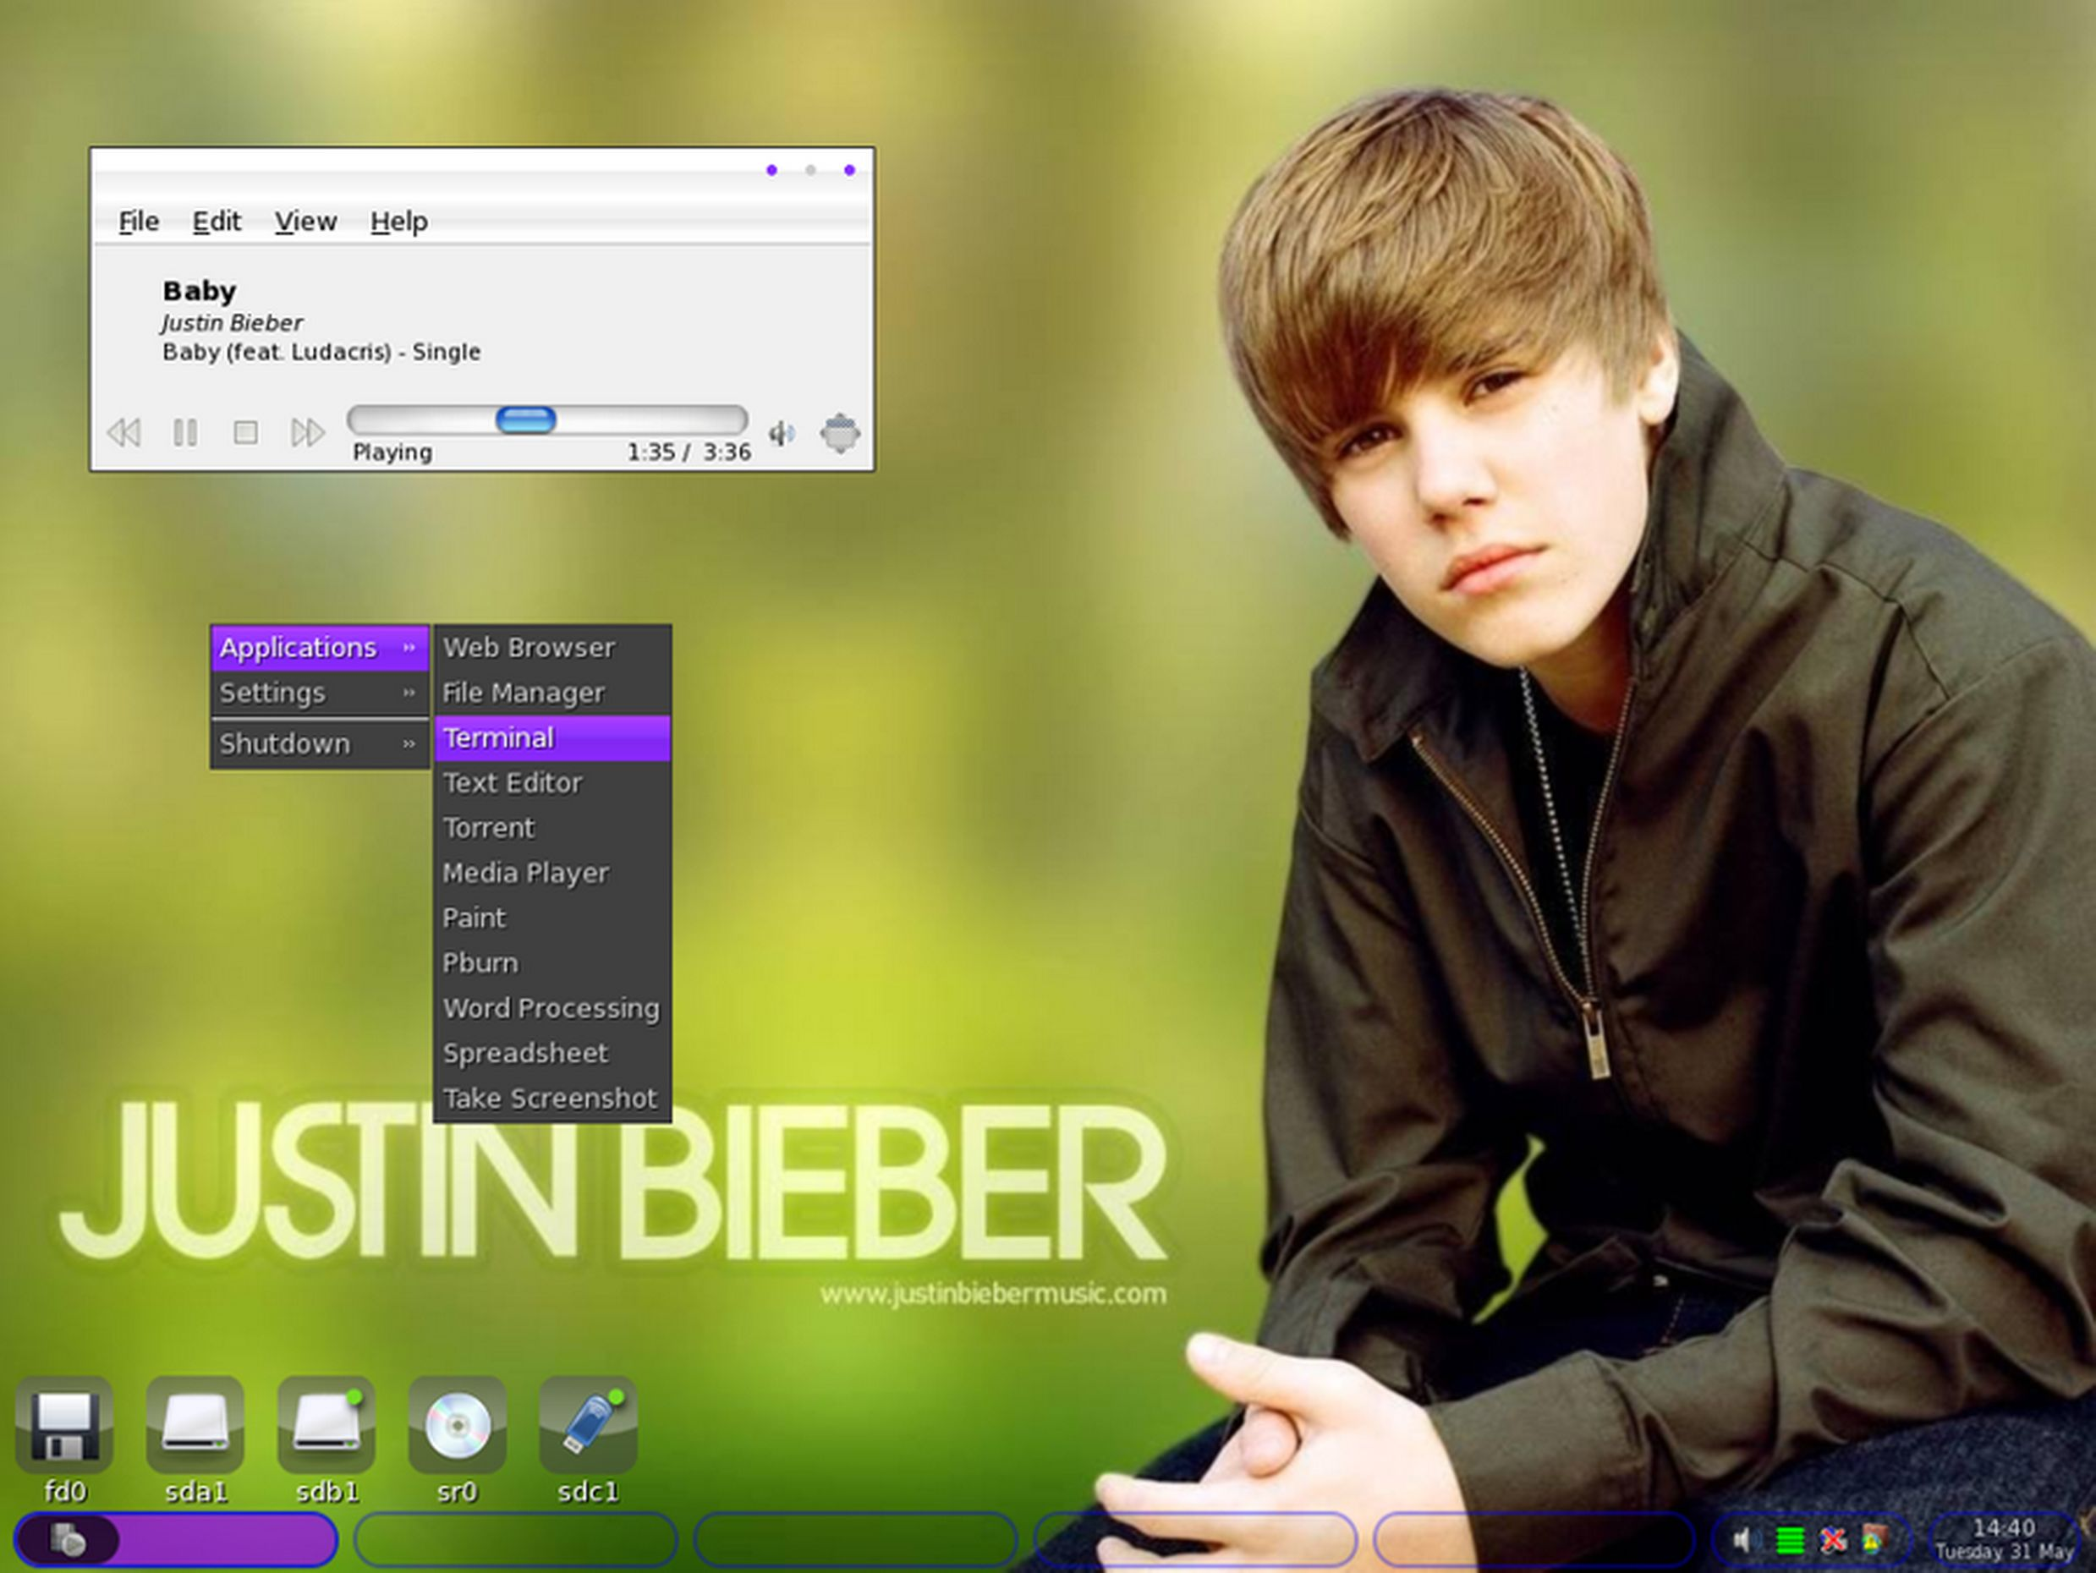

Slide 33
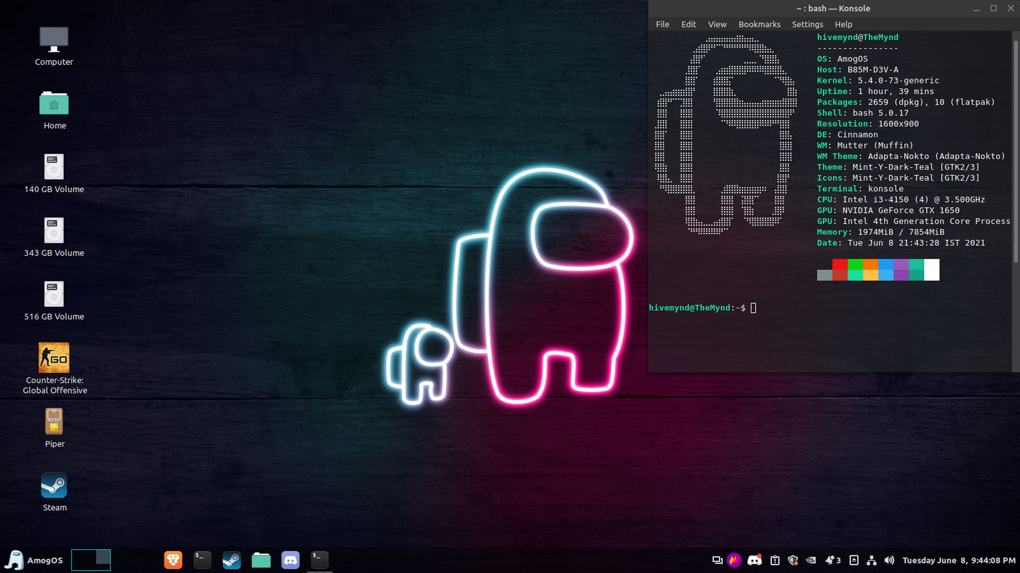

Slide 34
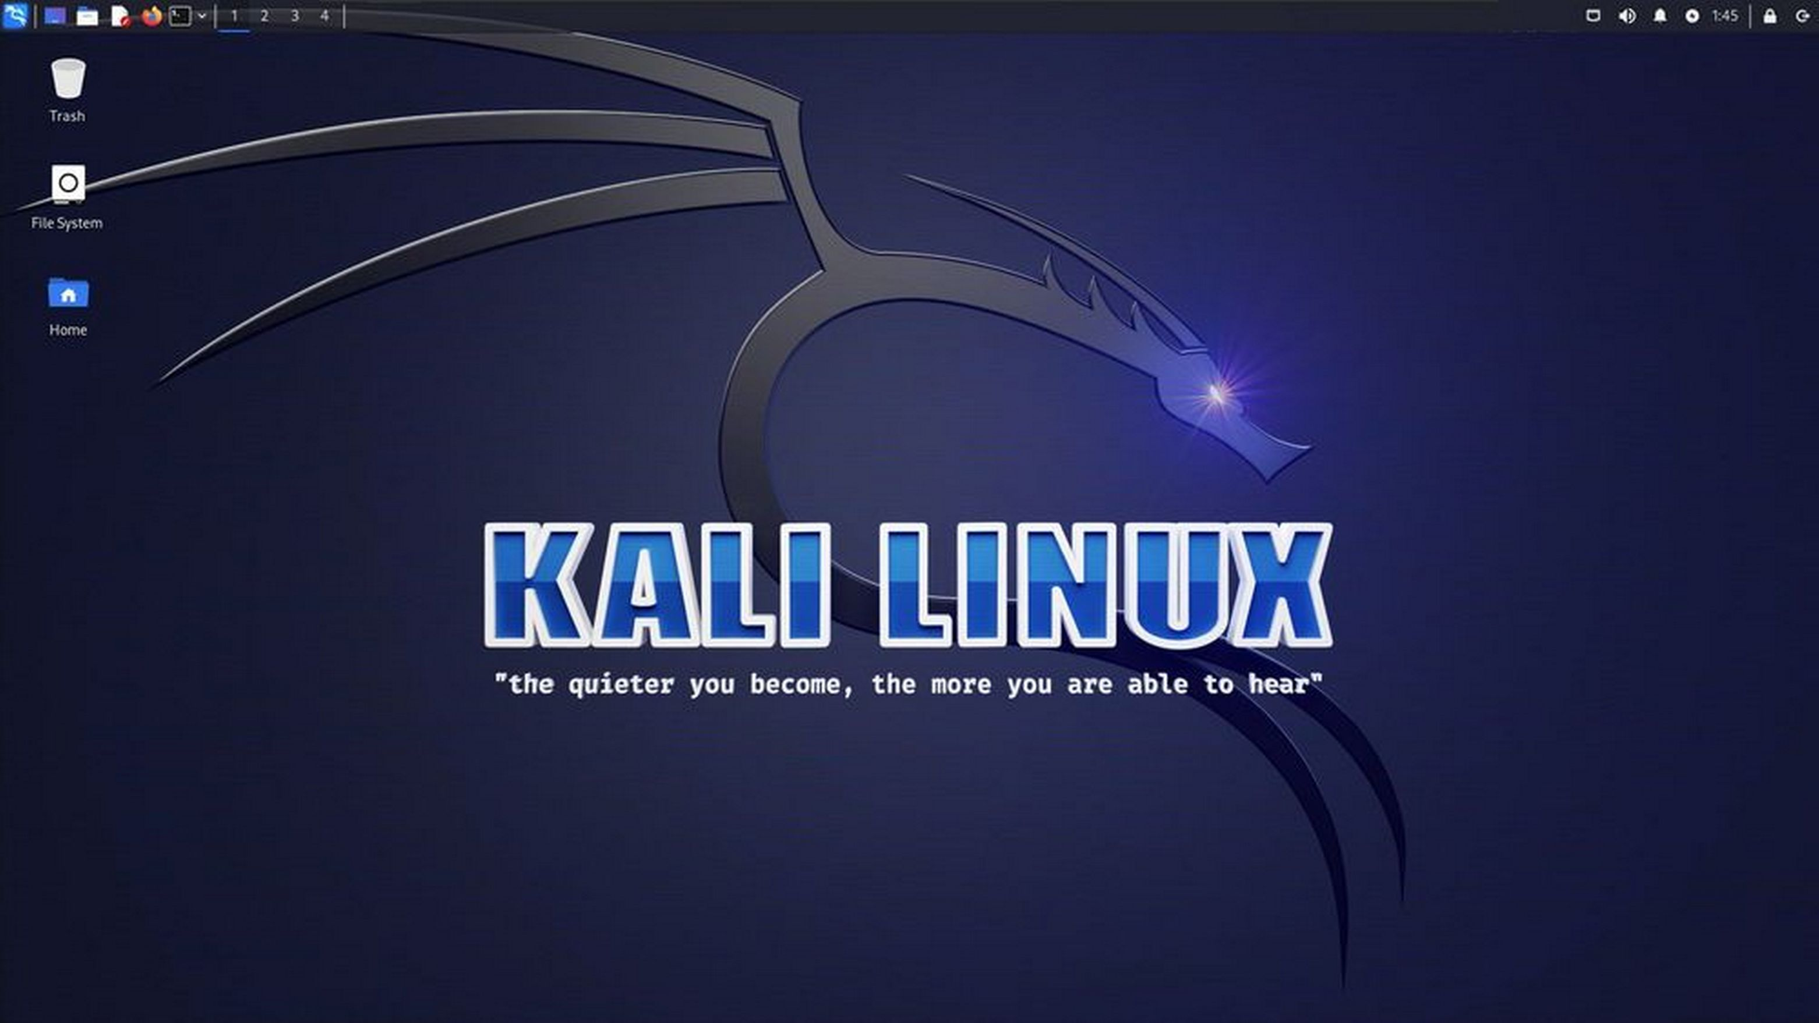

Slide 35
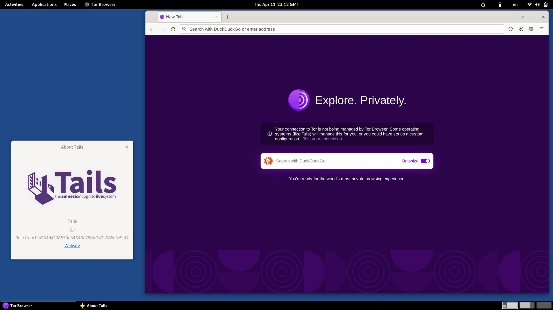

Slide 36
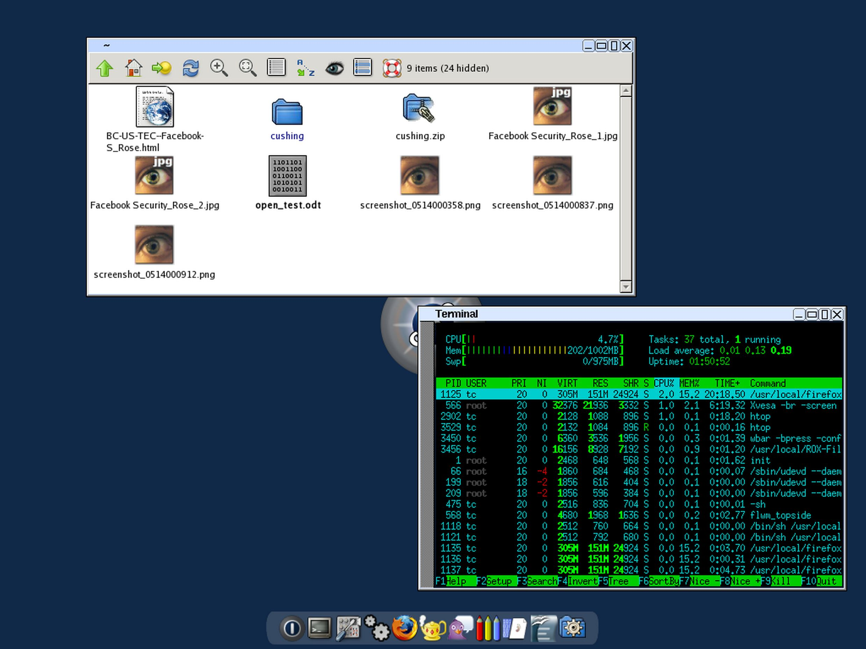

Slide 37


What is FOSS/FLOSS?
FLOSS
Free/Libre
Open Source
Software
FUBU:
From Us By Us
Community Software

Slide 38
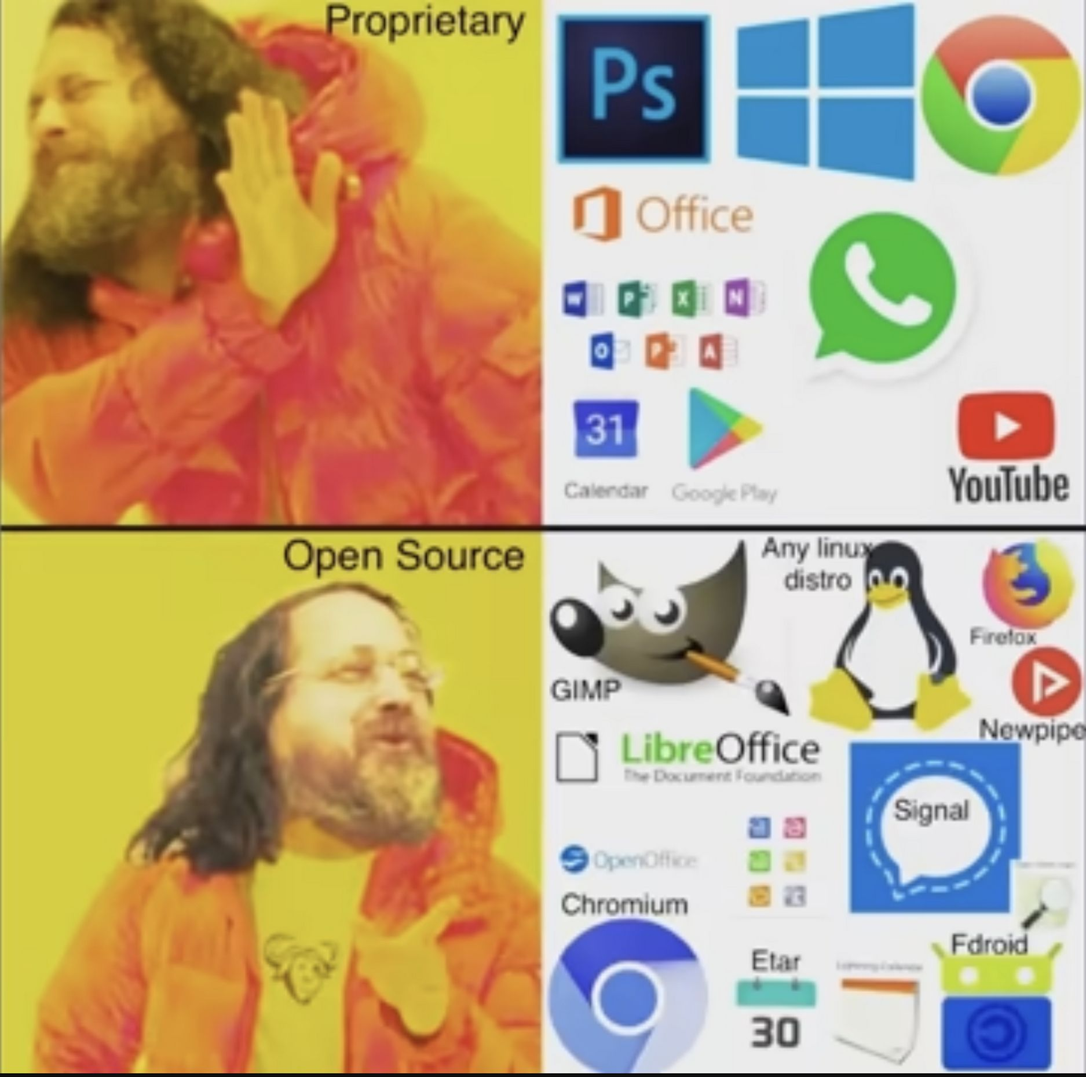

Slide 39
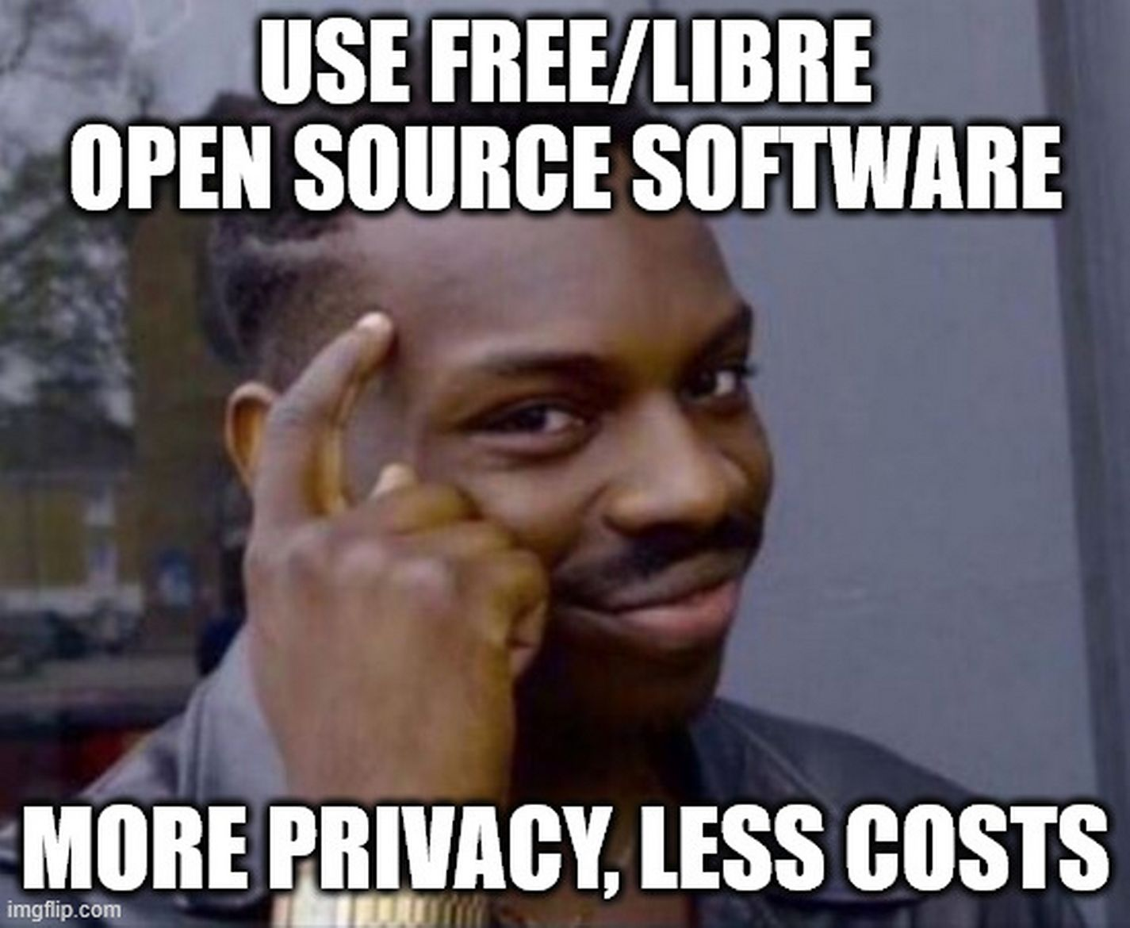
FOSS examples
Office Stuite: LibreOffice, OpenOffice, ONLYOFFICE
Graphics Editor: Gimp, Inkscape
Photo Editor: Dark Room
Video Editor: KDEnlive
Media player: VLC
Browser: Firefox, Chromium, Brave, Zen
Email Client: Thunderbird
Pasword Manager: KeePassXC

Slide 40
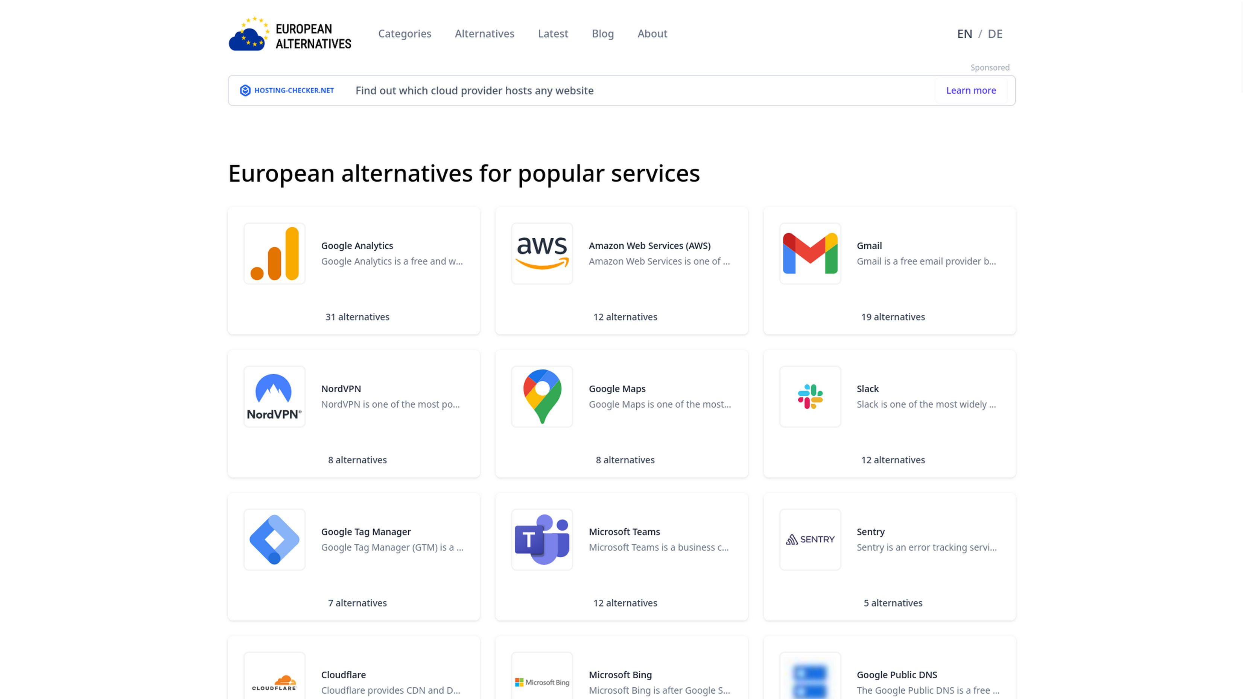

More alternatives

Slide 41
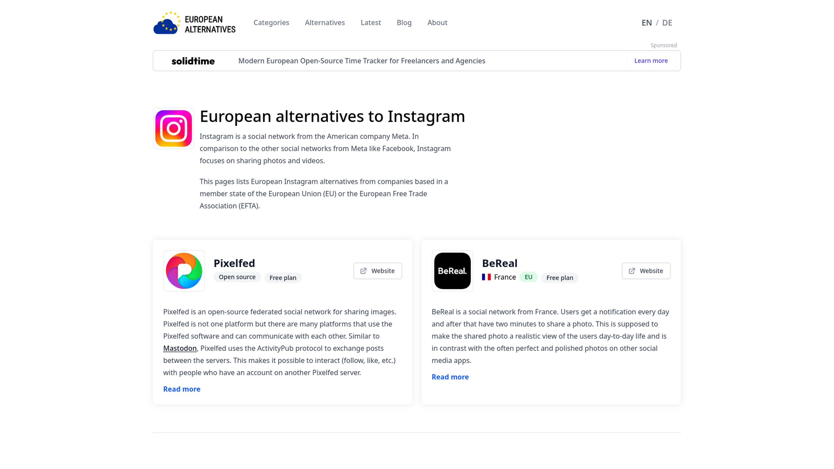

Slide 42
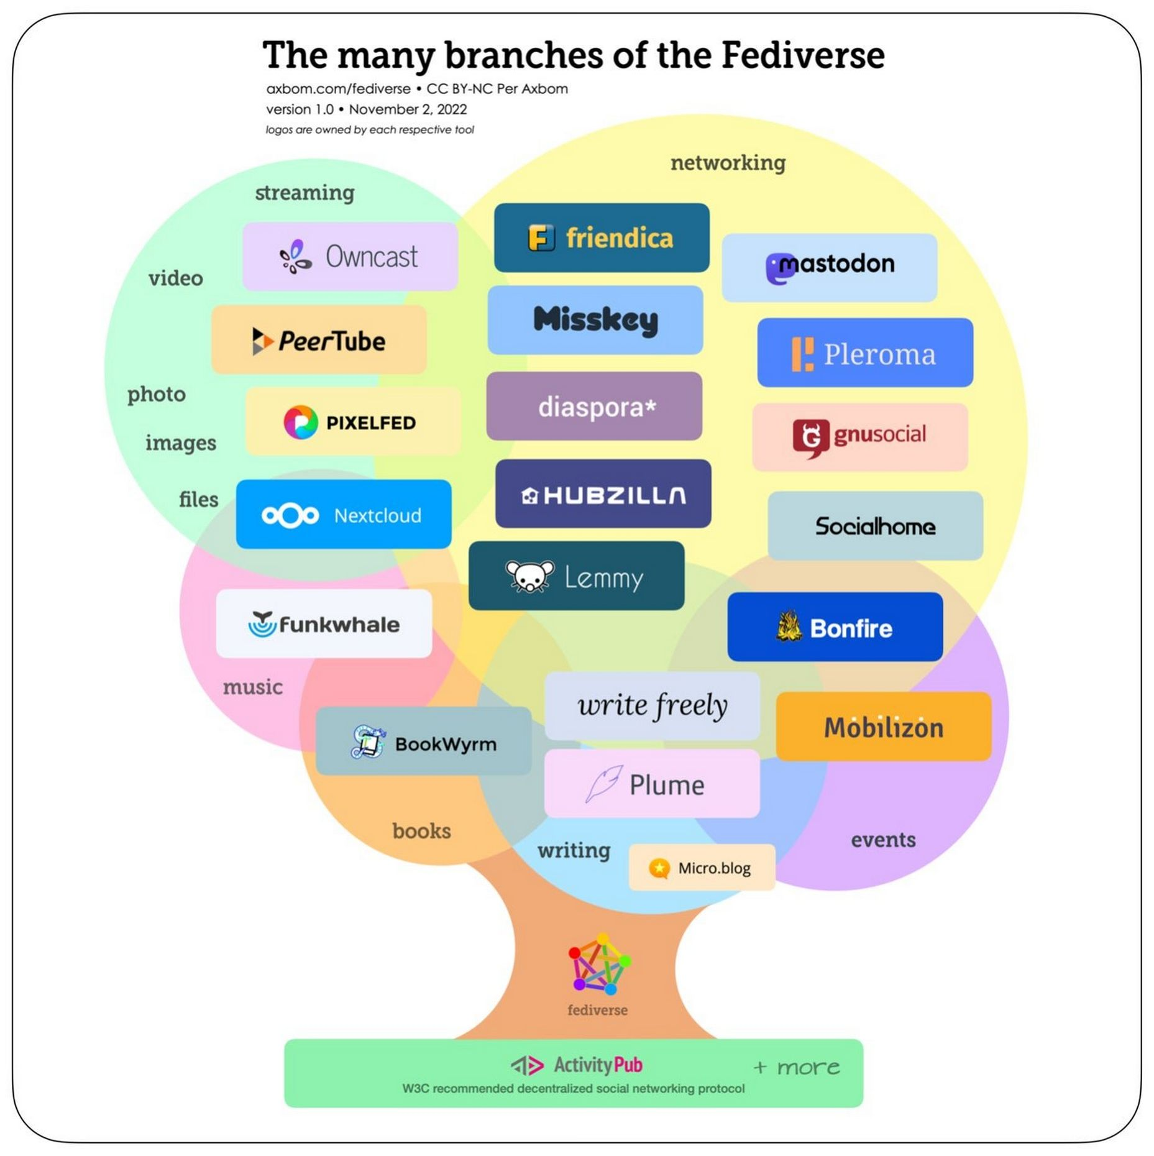


Slide 43
FOSS & Privacy Channels
https://www.youtube.com/@techlore
https://www.youtube.com/@MentalOutlaw
https://www.youtube.com/@TheHatedOne

Slide 44


Hands-on Linux session

Slide 45

Test Linux Online
https://distrosea.com/

Slide 46
FOSS & Privacy Channels
https://www.youtube.com/@techlore
https://www.youtube.com/@MentalOutlaw
https://www.youtube.com/@TheHatedOne

Slide 47

Installing Linux & Dual Booting
A Step-by-Step Overview for Beginners

Slide 48
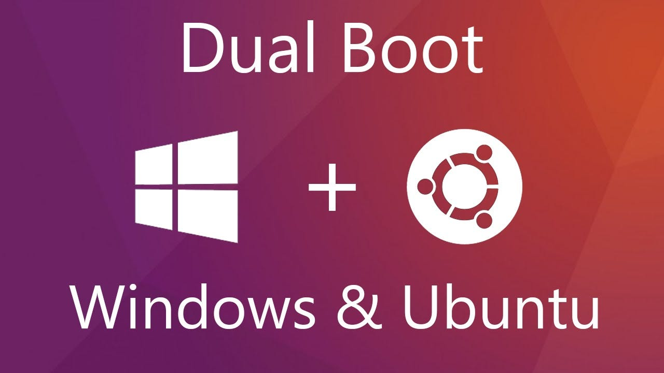
Introduction to Linux
Linux is an open-source operating system.
Popular distributions: Ubuntu, Fedora, Debian, Mint.
Benefits:
• Free
• Secure and stable
• Ideal for developers and servers

Slide 49
Preparing for Installation
Backup your important data.
Download a Linux ISO (e.g., Ubuntu, Fedora).
Create a bootable USB drive using tools like Rufus or Etcher.
Check system requirements.
Plan disk partitions (Windows + Linux).

Slide 50
Dual Boot Setup
Boot from the Linux USB.
Choose 'Install alongside Windows'.
Allocate space for Linux partition.
Follow the installation wizard.
Reboot and select OS from the boot menu (GRUB).

Slide 51
Tips & Troubleshooting
Keep your BIOS/UEFI settings in mind (Secure Boot, Boot Order).
Update GRUB if Linux doesn’t appear in boot menu.
Use live USB to repair boot issues.
Explore dual-boot managers if you want more control.

Slide 52
Running Windows in Linux
Virtual Machine
Wine
WinBoat
Proton (Gaming)

Slide 53
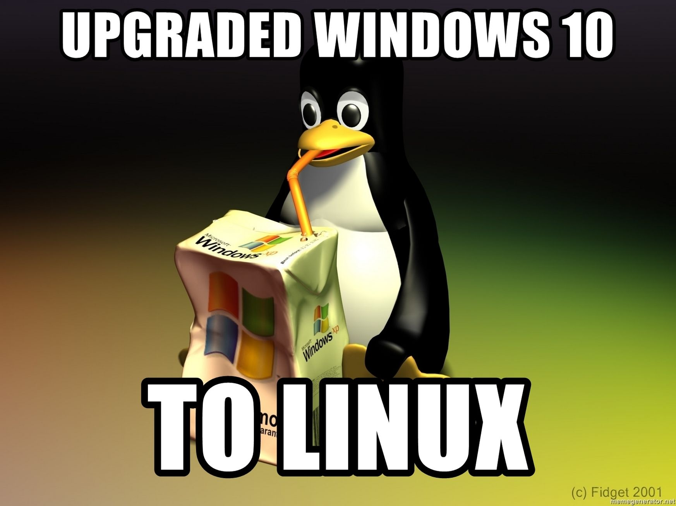
Thanks for your attention!

Slide 54
Hands-on Linux session

Slide 55
Educational Command Line Games
gitlab.com/slackermedia/bashcrawl
https://github.com/cpanici/LinuxAdventure
https://overthewire.org/wargames/bandit/

Slide 56

Slides are online at
https://onipabooks.com/tech/endof10.pdf

